Slide 1
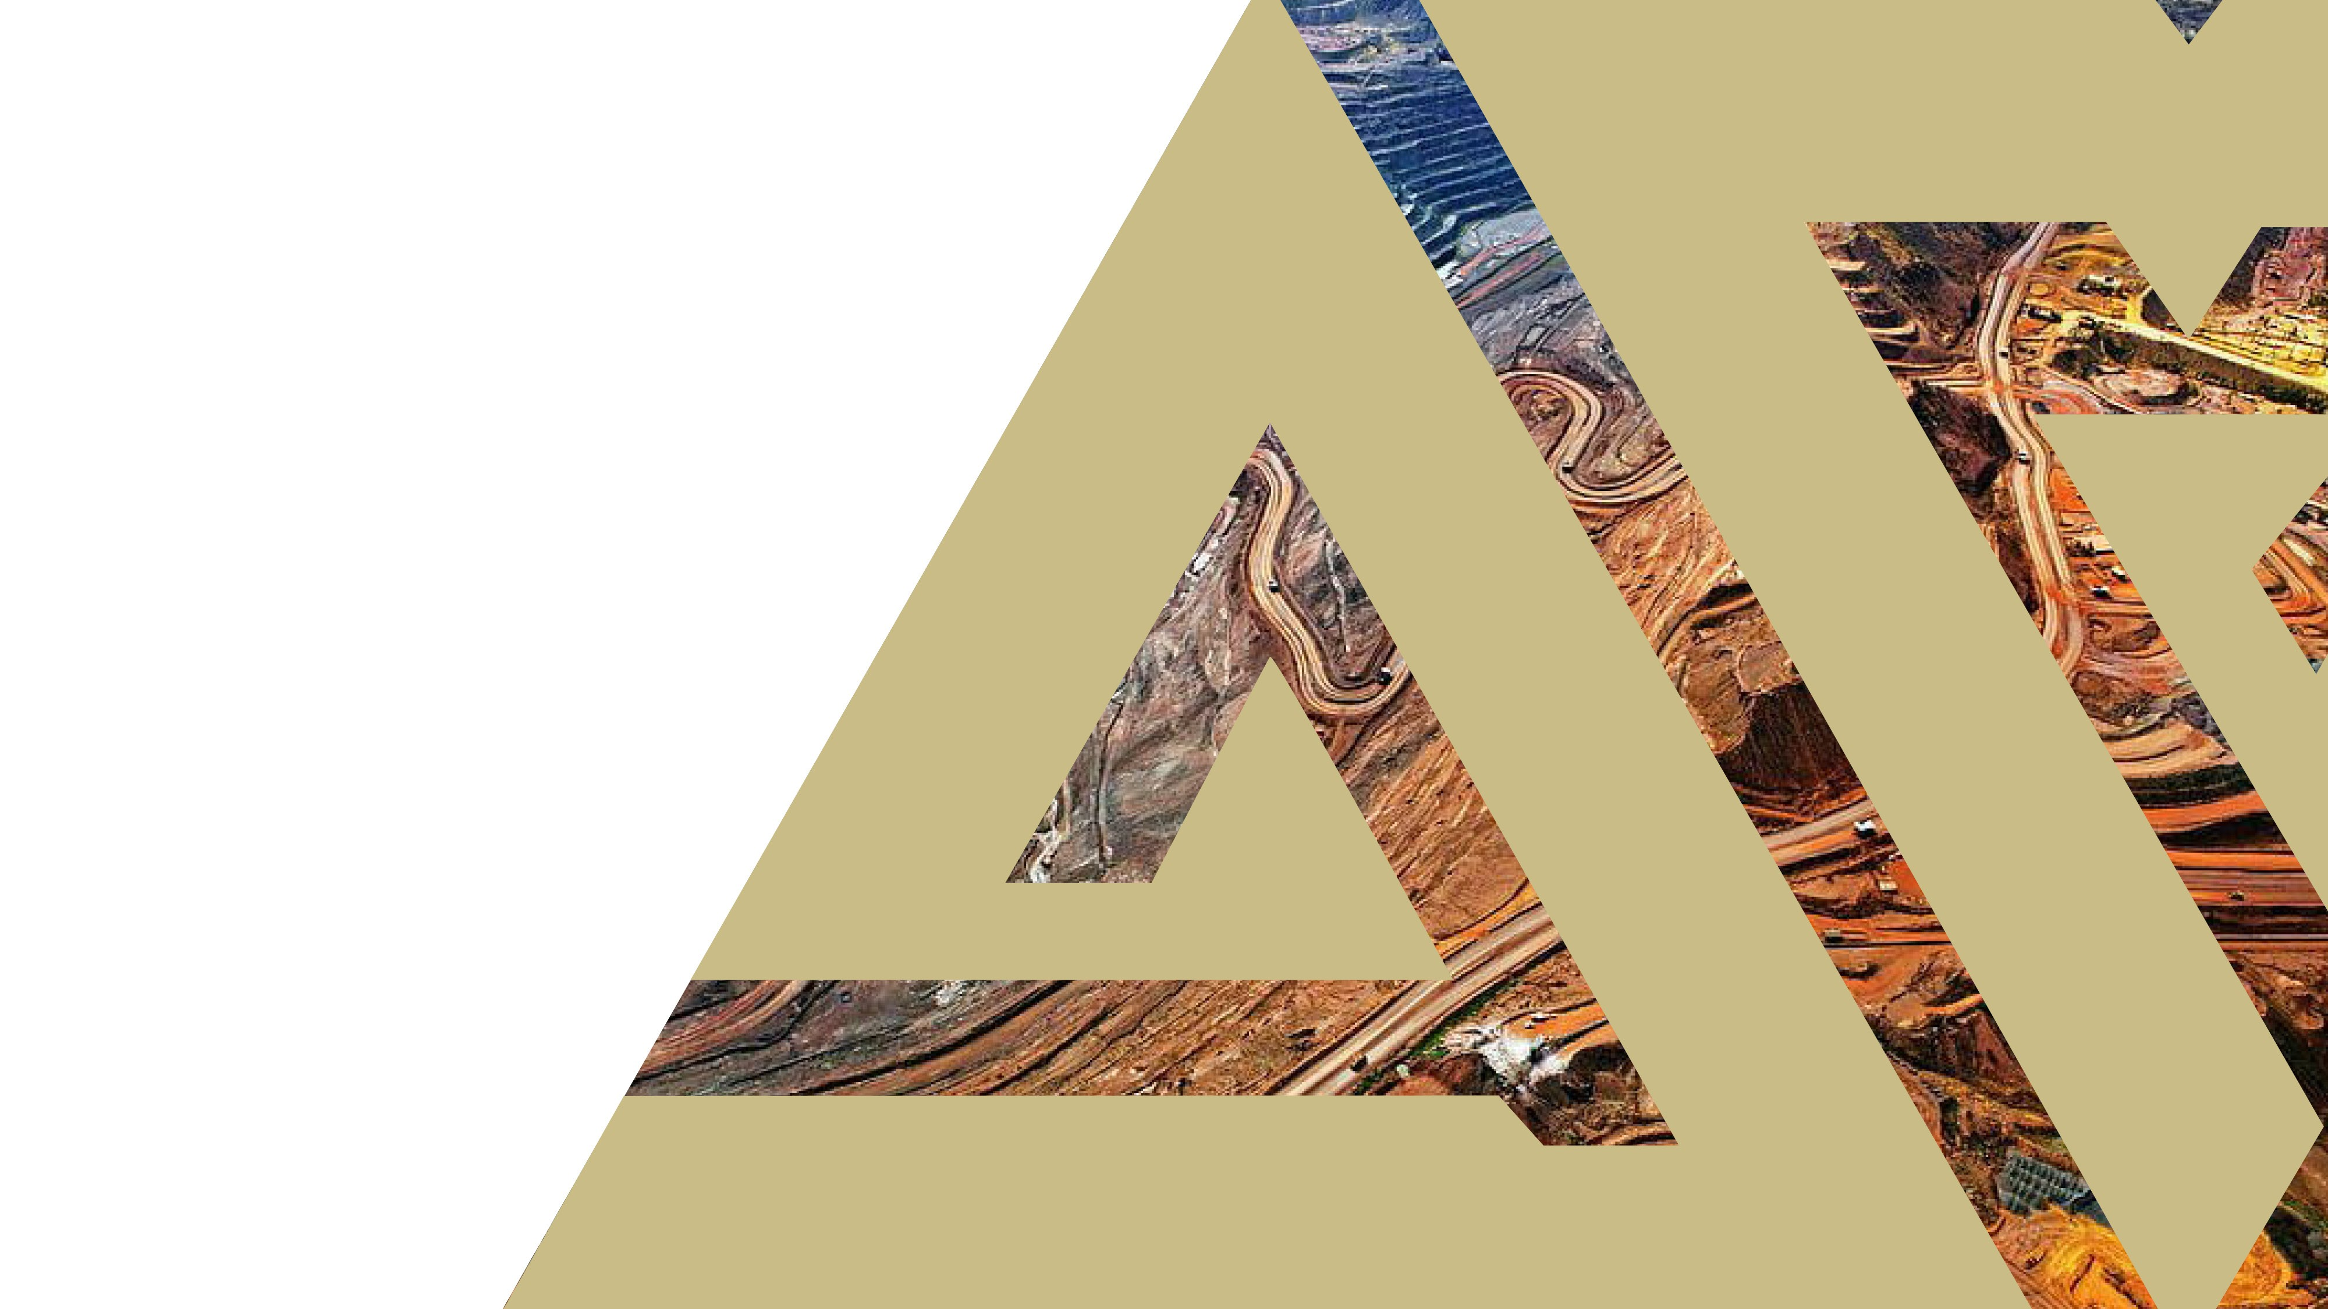
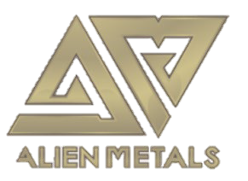
CORPORATE PRESENTATION
Precious and base metals explorer and developer
March 2021
AIM:UFO

Slide 2

Disclaimer & Competent Person Statement
The information in this presentation (the “Presentation”) relating to Alien Metals Ltd (the “Company”) has been prepared by the Company and may be subject to material updates, revision and further amendment. This Presentation is for background purposes only and does not constitute or form part of, and should not be construed as, an offer for sale or subscription of, or solicitation of any offer to purchase or subscribe for, any shares in the Company nor should it form the basis of, or be relied on in connection with, any contract or commitment whatsoever.
This Presentation has not been approved by any authorised person pursuant to Section 21 Financial Services and Markets Act 2000 ("FSMA") and is therefore being issued for information purposes only to a very limited number of persons and companies falling within one of the exemptions contained in the Financial Services and Markets Act 2000 (Financial Promotion) Order 2005 (as amended) (the "Order"). This Presentation and its contents are exempt from the general restriction (in section 21 FSMA) on the communication of invitations or inducements to engage in investment activity on the grounds that it is being given only to (i) persons outside the United Kingdom (ii) persons who have professional experience in matters relating to investments who fall within the definitions of investment professionals as defined in Article 19 of the Order (iii) persons who fall within Article 43 of the Order, (iv) and persons who fall within Article 49 of the Order (high net worth companies and trusts and other persons of the kind to which Article 49(2) of the Order applies. Persons not falling within these categories should not rely or act upon this Presentation and in consideration of receipt of this Presentation each recipient warrants and represents that he or it is a person falling within that description.
The information in this Presentation which relates to Exploration Targets, Exploration Results and Mineral Resources or Ore Reserves is based on information compiled by Mr Allen Maynard, who is a Member of the Australian Institute of Geosciences (“AIG”), a Corporate Member of the Australasian Institute of Mining & Metallurgy (“AusIMM”) and an independent consultant to the Company. Mr Maynard is the Director and principal geologist of Al Maynard & Associates Pty Ltd and has over 40 continuous years of exploration and mining experience in a variety of mineral deposit styles. Mr Maynard has sufficient experience which is relevant to the style of mineralisation and type of deposit under consideration and to the activity which he is undertaking to qualify as a Competent Person as defined in the 2012 Edition of the “Australasian Code for reporting of Exploration Results, Exploration Targets, Mineral Resources and Ore Reserves” (JORC Code). Mr Maynard consents to the inclusion of the information compiled by him in this Presentation in the form and context in which it appears.
Whilst the information contained herein has been prepared in good faith, the Company does not give or have authority to give any representations or warranties whether express or implied as to the accuracy, reliability or completeness of the information, or of any written or oral revision thereof. The Company therefore accepts no liability, whether direct or indirect, express or implied, contractual, tortious, statutory or otherwise in relation to the information contained in this Presentation.
The issuing of this Presentation does not constitute an undertaking or obligation by the Company to update or correct any inaccuracies or omissions from this Presentation which may become apparent.
All statements, other than statements of historical fact, contained in this Presentation constitute forward-looking statements based on expectations, estimates and projections as of the date of this Presentation, including but not limited to statements relating to increases in mineral resources and reserves, capital and operational expenditures and sustaining capital, cash costs per ounce, grades and recoveries, NPV and IRR, the Company’s results of operations, financial position, revenue, profit, silver production, liquidity, availability of finance, prospects, growth, strategies, the silver price and the silver industry.
Such forward-looking statements are subject to a number of risks, uncertainties and other factors which may cause actual results, performance and developments to differ materially from those expressed or implied by such statements including, without any limitation whatsoever, the availability of mining, environmental or other operating permits; the failure of plant, equipment or processes to operate as anticipated; the speculative nature of mineral exploration and development; operating or technical difficulties in mineral exploration; development and mining activities; reliability of calculation of mineral reserves and resources and precious metal recoveries; availability, of and costs associated with, mining inputs and labour; accidents; requirement for additional capital; the price of silver; general economic and business conditions; industry trends; competition; changes in regulation; taxation; controls and legislation; currency fluctuations (including the US dollar, Australian dollar and Mexican Peso exchange rates); the Company’s ability to develop new reserves, including its ability to convert its resources into reserves and its mineral potential into resources or reserves; changes in its business strategy; changes in national and local governments; and political and economic uncertainties. Therefore, although the Company believes that the expectations reflected in such forward-looking statements are reasonable, the Company neither gives assurance that such expectations are accurate or guaranteed nor assumes any obligation to update the information contained therein, other than as required by the applicable law.
AIM:UFO | 2

Slide 3


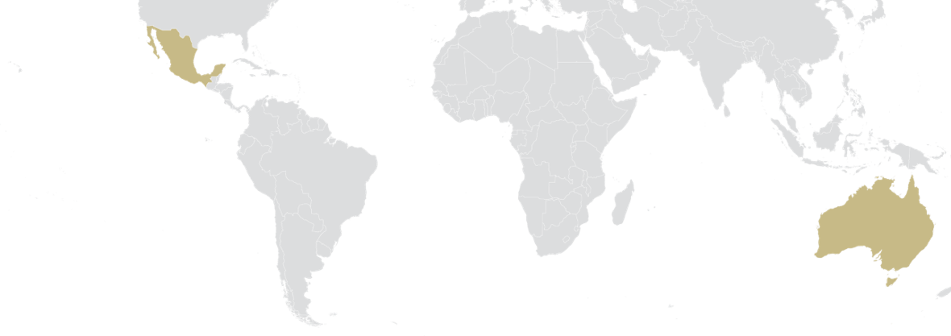



COMPANY OVERVIEW
Project developer, unlocking value from a diverse portfolio of assets
Ag
Cu
Fe
ACQUISITIVE STRATEGY
Generating value through the exploration of low-cost acquisitions
DIVERSIFIED PORTFOLIO
Multi-mineral portfolio of diverse assets in tier one jurisdictions around the world
SILVER, COPPER AND IRON ORE UPSIDE
High grade Silver, Copper and Iron Ore projects - commodities with positive price forecasts
JOINT VENTURES
Joint Ventures lower risk and provide funding from third party major mining companies
EXPLORATION
Potential for significant upside in all projects as they progress up the value curve
EXPERIENCED TEAM
Focused team with 50+ years technical expertise, proven in M&A and delivering value

Slide 4
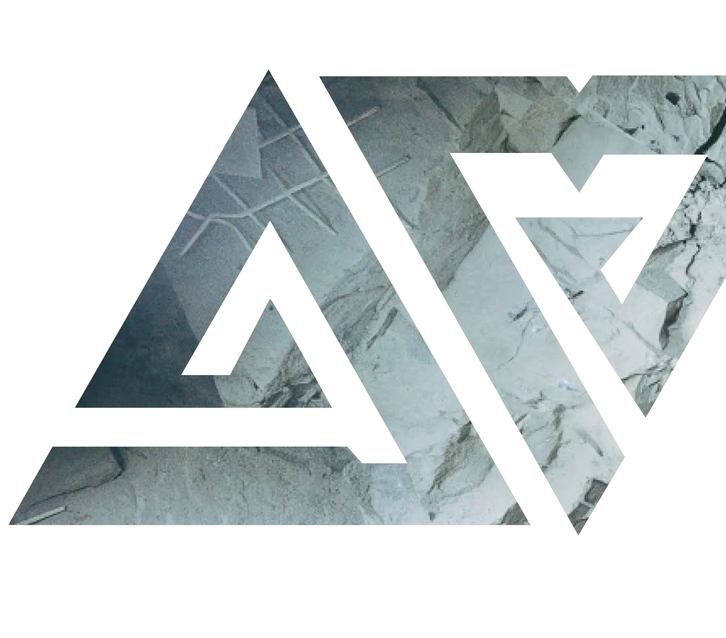
BOARD AND MANAGEMENT
Recognised experts in global mining with a proven track record of building value
DAN SMITH
Non-Executive Chairman
13+ years capital markets experience as Director of AIM/ASX resources companies
Founder of Minerva Corporate Pty Ltd
Current board positions Europa Metals (AIM), White Cliff Minerals (ASX) and Artemis Resources (ASX)
BILL BRODIE GOOD
CEO & Technical Director
25+ years in mineral exploration
5 years as a Principal with SRK Exploration Services Ltd, a leading global mining consultancy group
Extensive experience setting up exploration projects throughout Africa, Asia and Australia
MARK CULBERT
Non-Executive Director
Founding Partner of corporate and commercial litigation firm, over 20 years legal and business experience
TOM REDICLIFFE
Exploration Management
Tom has over 25 years in Exploration in various commodities predominantly in Australia. He is currently managing the Australian exploration programs for Alien.
HOWARD BAKER
Resource Geologist and QP, Iron Ore
With over 20 years experience in Iron Ore project evaluation, exploration and Resource calculation Howard brings a wealth of experience to the team.

Slide 5
MULTI-MINERAL PROJECT PORTFOLIO
A global, diversified mining company with prospective projects in Mexico, Australia and Greenland
AUSTRALIA
Ag
Ni
Cu
PGE
Fe
GREENLAND
Elizabeth Hill (100%) - Silver
Historic high grade silver mine
Grade averaging 2,195 g/t
Ag Field exploration started
POW for trenching and drilling granted
Munni Munni North
117km² exploration permit around Elizabeth Hill
Numerous Ni, Cu, PGE targets
Exploration planning underway
Hamersley (51%) - Iron Ore
Two prospective direct shipping iron ore projects in world class Pilbara region of WA
Exploration Target up to 245mt Maiden Drilling underway
Zn
EL 2020-44 - Zinc
208km² surrounding Citronen Zinc-Lead project owned by Ironbark Zinc (ASX: IBG)
Data review underway
Seeking Joint Venture partner
Ag
Cu
Au
Ag
MEXICO
Los Campos (100%) - Silver
Historic mine in Zacatecas
High grade samples include 547 g/t Ag
Maiden Drill program due 2021
Donovan 2 (100%) – Copper/Gold
25km from Teck San Nicolas VMS deposit
Sample results 3.34% Cu and 2.68 g/t Au
US$10m farm-in agreement with Capstone Mining begun
Maiden Drilling started
San Celso (100%) - Silver
2 historic underground silver mines.
High grades up to 1,389 g/t Ag, average of 441 g/t Ag.
Maiden Drilling program due 2021

Slide 6
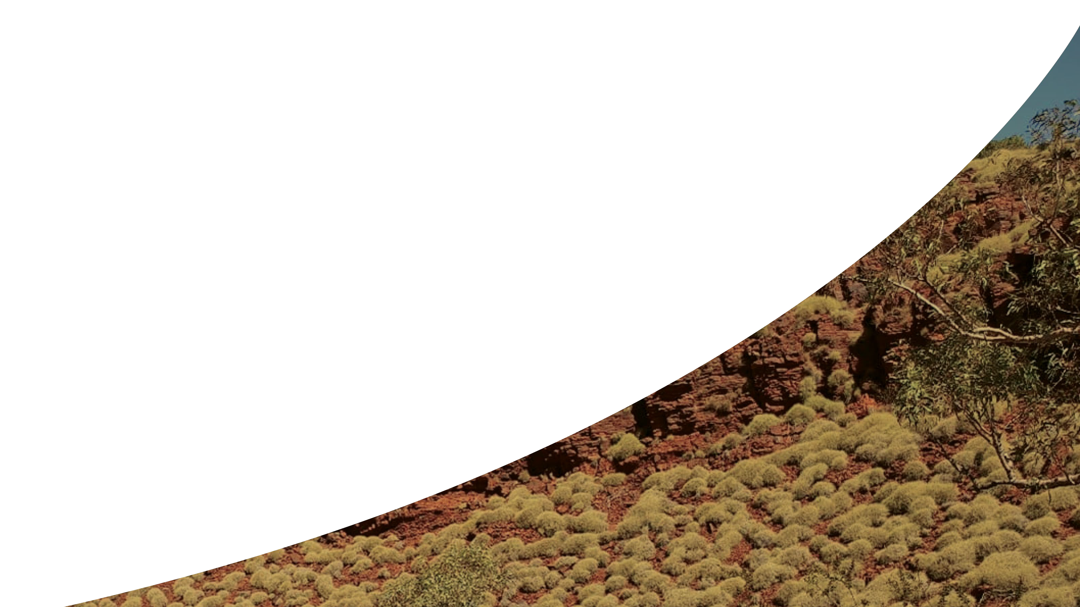


GROWTH STRATEGY
Advancing multiple assets up the value curve
GROW
Enhance shareholder value through
incubation and
asset realisation
PARTNER
Establish partnerships to fund further exploration and development
EXPLORE
Add value through exploration of assets
ACQUIRE
Low-cost acquisitions focused on precious and base metals with positive price outlook
AIM:UFO | 6

Slide 7
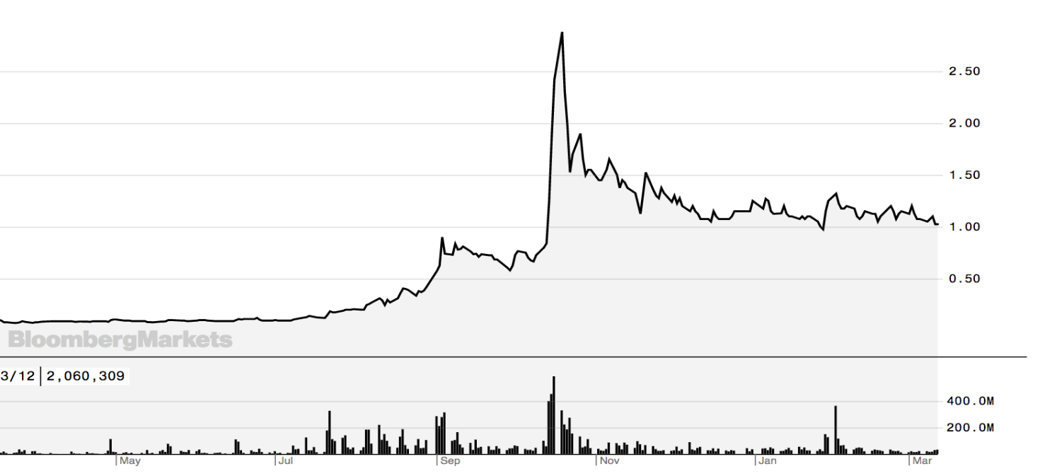


CAPITAL STRUCTURE
KEY DATA
UFO Share Price
AIM
MARKET
UFO
TICKER
£35m
MARKET CAP
0.07p – 2.88p
52 WEEK SHARE PRICE
3,423m
ISSUED SHARE CAPITAL
74.8m
MANAGEMENT OPTIONS
439m
SHARE WARRANTS
800%
1 YEAR RETURN
£100m shares traded in 6 months
Source: Bloomberg VWAP 1.4p
MAJOR SHAREHOLDERS
Windfield Metals Gravner
6.4%
5.9%
**Warrants with a range of exercise prices between £0.0012 to £0.006 over the next 3 years.

Slide 8
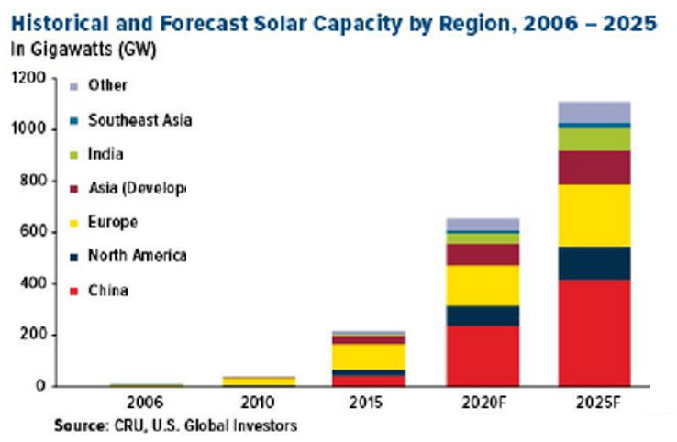
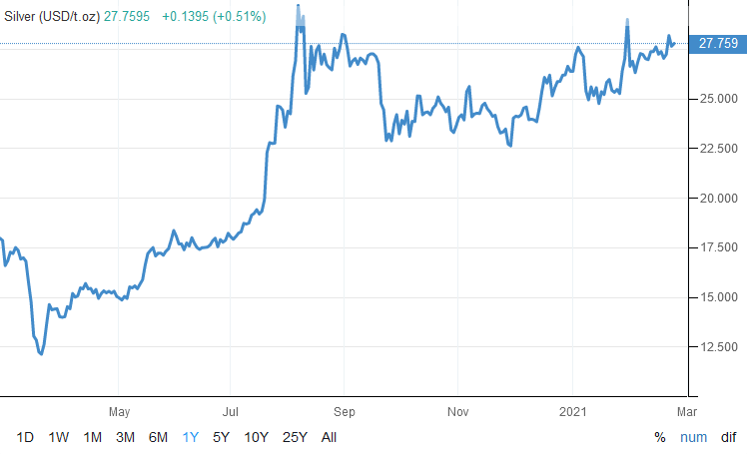
COMMODITY OUTLOOK
Silver has performed strongly and have excellent price outlooks
Ag
Silver
Vital component in solar cells, electronics, Battery Electric Vehicles (BEVs)
Wide applications in healthcare, including the manufacture of PPE
Increased fiscal stimulus globally driving further investment demand
Price up 130% from March 2020 low
Maintaining strong levels > $25 USD/Oz
Gold/Silver Ratio down from +110:1 to 65:1
Increasingly being seen as a viable store of value by investors, similar to gold

Slide 9
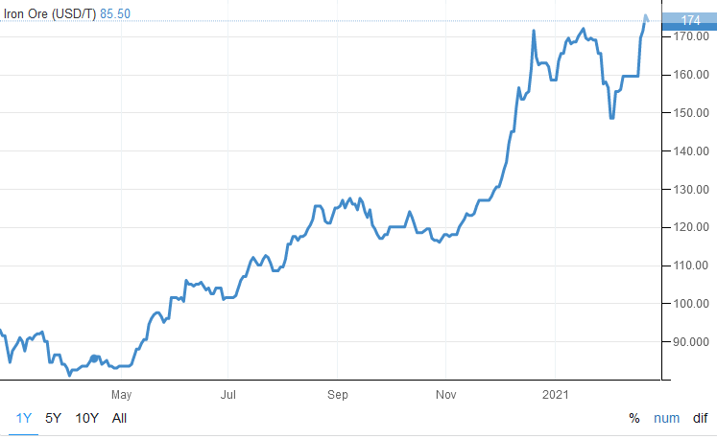
COMMODITY OUTLOOK
Iron Ore has performed strongly and have excellent price outlooks
Fe
Iron Ore
Key component in steelmaking and thus driven by spend on construction and infrastructure
One of the top performing metals in 2020
Price up ~100% in past year from US$88 – US$174
Driven largely by Chinese demand having seen a sustained and robust rebound from the pandemic
Investment in infrastructure a key pillar of growth in the region
Global supply seeing significant squeeze, driving prices further
Iron ore hit its highest price since September 2011 on first trading day following Lunar New Year 2021 in China
Iron Ore spot price for last 12 months

Slide 10
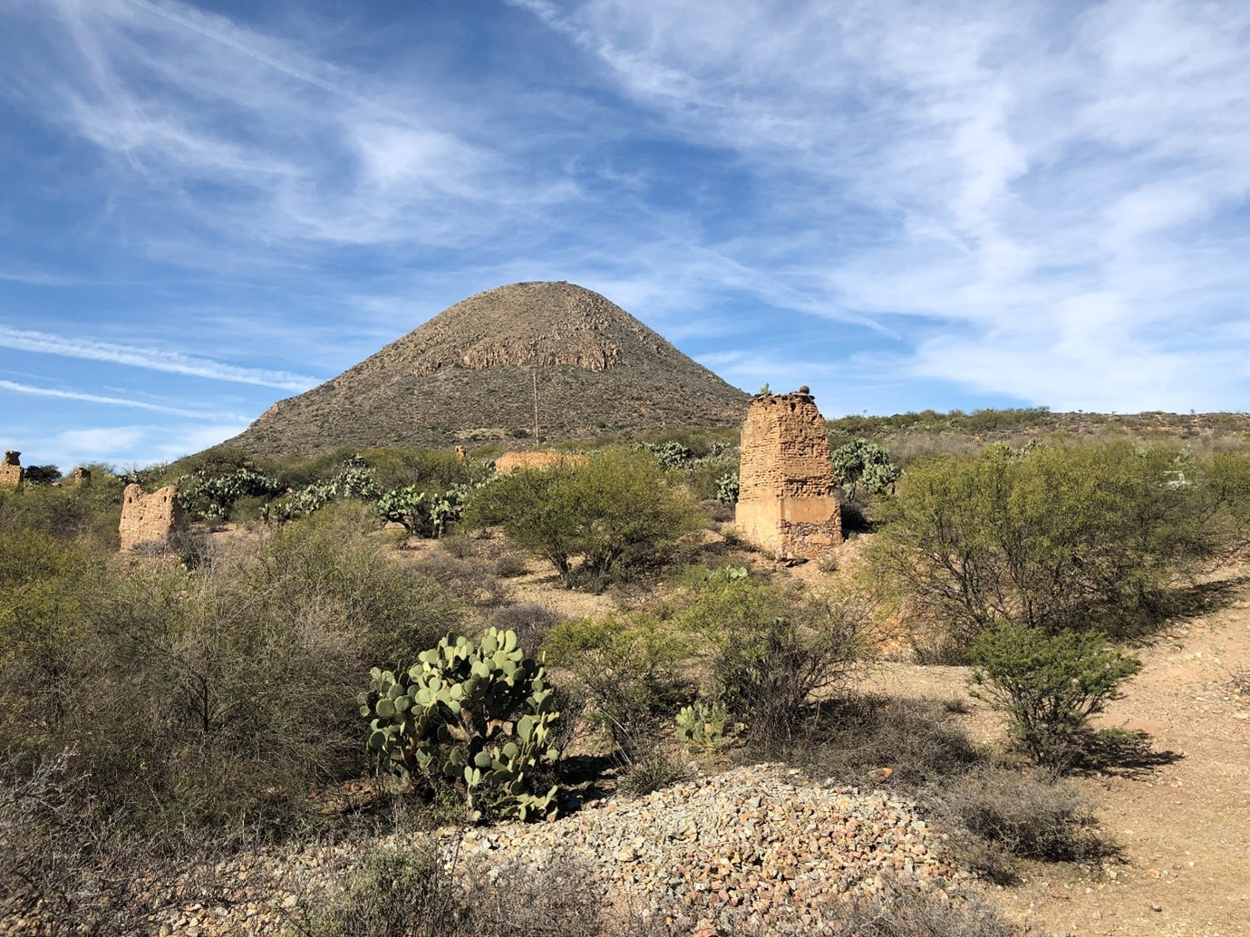

MEXICAN COPPER/GOLD & SILVER PORTFOLIO

Slide 11
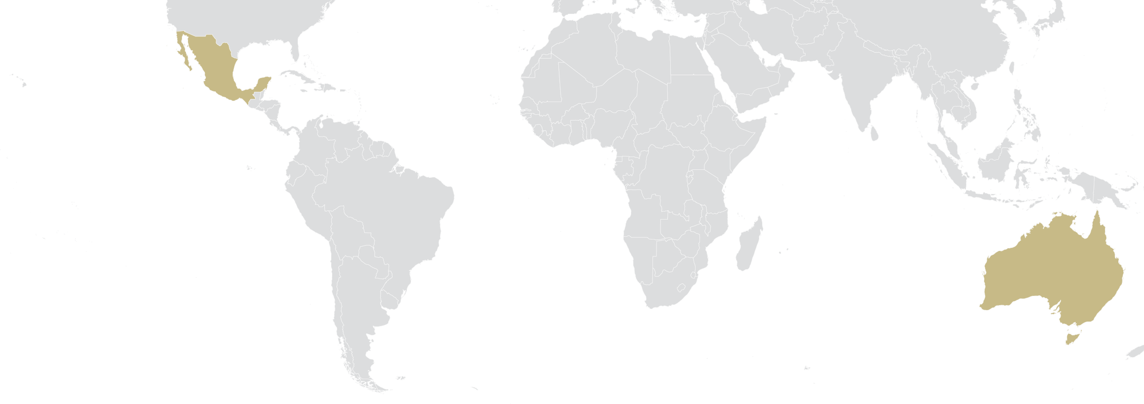
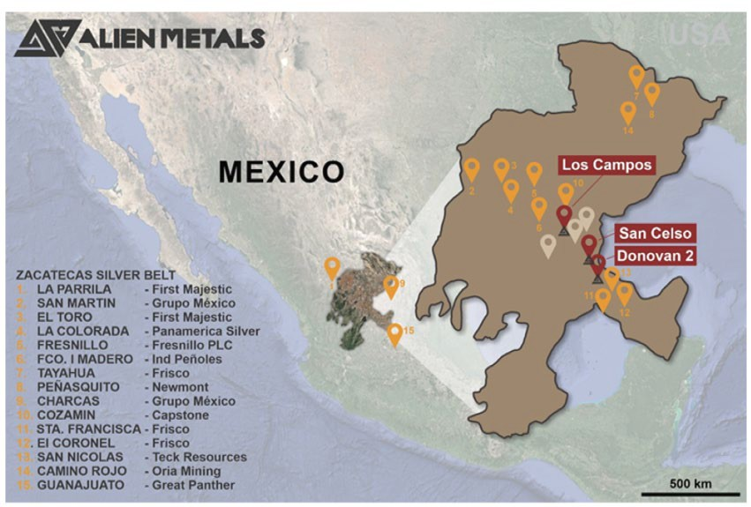
MEXICAN PORTFOLIO
Highly prospective Copper/Gold and Silver projects
Key projects:
  Donovan 2 (Copper/gold)
  San Celso (Silver)
  Los Campos (Silver)
Donovan 2 in ideal location and geological setting to host VMS deposit
Silver projects host Bonanza Grade historic mines, excellent potential for on strike and down dip extensions
Neighbours: Teck, Fresnillo, Carlos Slim (Minera Frisco), Endeavour Silver (market cap ranging from 250m- $1b)
Excellent mining jurisdiction

Slide 12
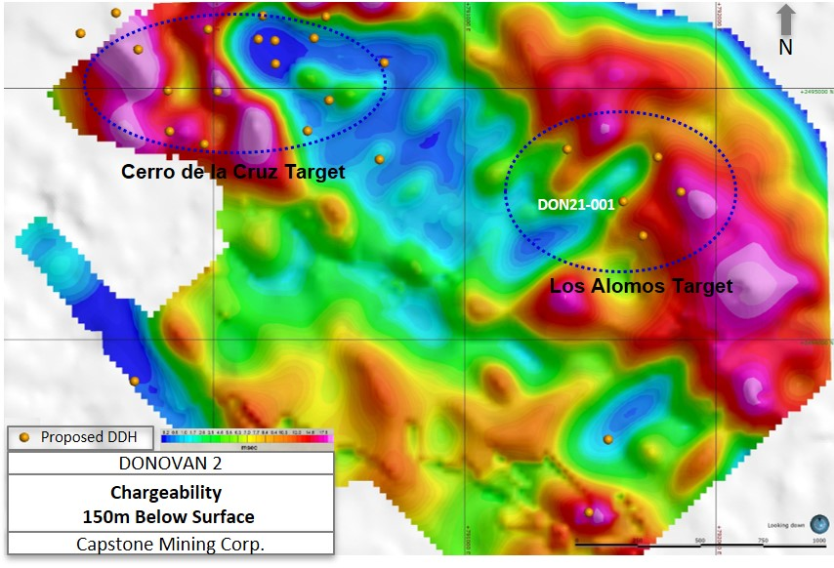
DONOVAN 2 (COPPER/GOLD)
Capstone Mining Farm-in agreement commenced
Capstone Mining commenced sole funding to develop project with multi-million dollar investment
First stage sees Capstone spend US$3.6m on exploration and making a cash payment of US$290k to Alien in order to earn a 65% interest in the project
Close spaced in-fill IP survey in 2020 to consolidate Drill Targeting
Maiden drilling program of 2,500m started February 2021 to follow on completion 2019 surface sample results included:
  3.34% Cu
  2.68 g/t Au
Located 24km from Teck Resources San Nicolas Project, resource:
  108Mt @ 1.16% Cu, 1.6% Zn,
0.43 g/t Au and 24.5 g/t Ag
Location of provisional drill holes over Chargeability -150m depth, Donovan 2, February 2021 (Capstone Mining Corp.)

Slide 13
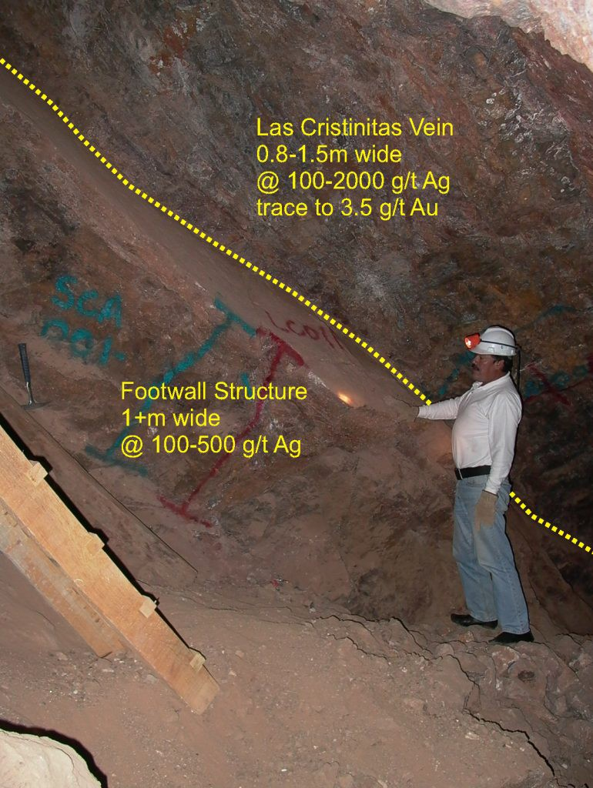
SAN CELSO (SILVER)
Bonanza Grades
San Celso hosts two historic underground silver mines that contained Bonanza Grades:
  Historic grades up to 2683 g/t Ag (~86 oz/t Ag)
  Recent sample grades up to 1,389 g/t Ag (~44 oz/t Ag), averaging 441 g/t Ag (~14 oz/t Ag) from 96 samples
Numerous stopes indicating the presence of high-grade silver ore shoots off main veins
Footwall mineralisation also apparent yet unmined
800m+ known strike of main vein systems within current licence area, open at depth
Indications are mineralization continues at depth below historic mining and on strike in both directions
Funding available for maiden drilling
Environmental permit for drilling being sought
Contiguous Nueva Andromeda Permit acquired by Alien early 2021 to add potential
Las Christinitas Ore Body in historic workings, San Celso Project, 2006

Slide 14
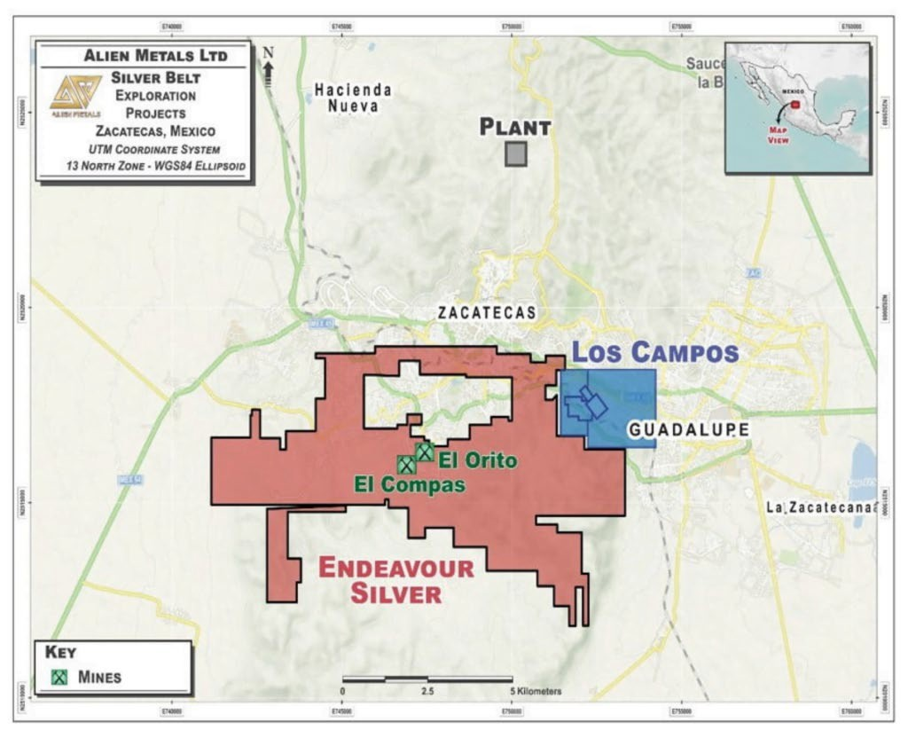

LOS CAMPOS (SILVER)
Average reported head grade of over 1,000 g/t Ag
10km east of Endeavour Mining Corp’s 6moz El Campos Silver Mine
  Comparable mineralized system
Los Campos includes:
  Two historic silver mines targeting two high-grade epithermal silver veins
  Average reported head grade of over 1,000 g/t Ag
  Historic waste/ore dumps remain to be tested for silver content
  Recent high-grade samples taken by Alien including 547 g/t Ag (18oz/t)
Maiden Drill program permission being sought
Alien funded for Maiden Drilling program
Alien recruited a permanent Senior Geologist based in Zacatecas early in 2021 to the team to increase presence and technical capacity in country
100%
Location of Los Campos Project in relation to Endeavour Silver El Campos Silver Mine, Mexico Silver Belt

Slide 15
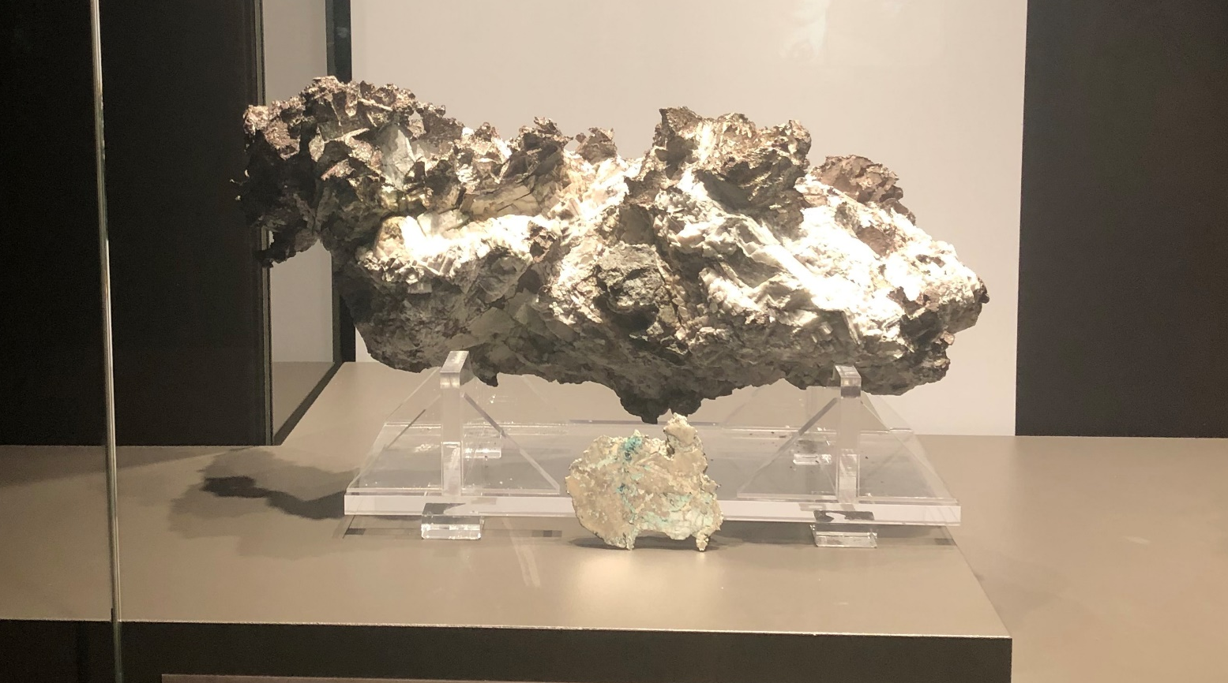
ELIZABETH HILL SILVER PROJECT, WESTERN AUSTRALIA

Slide 16
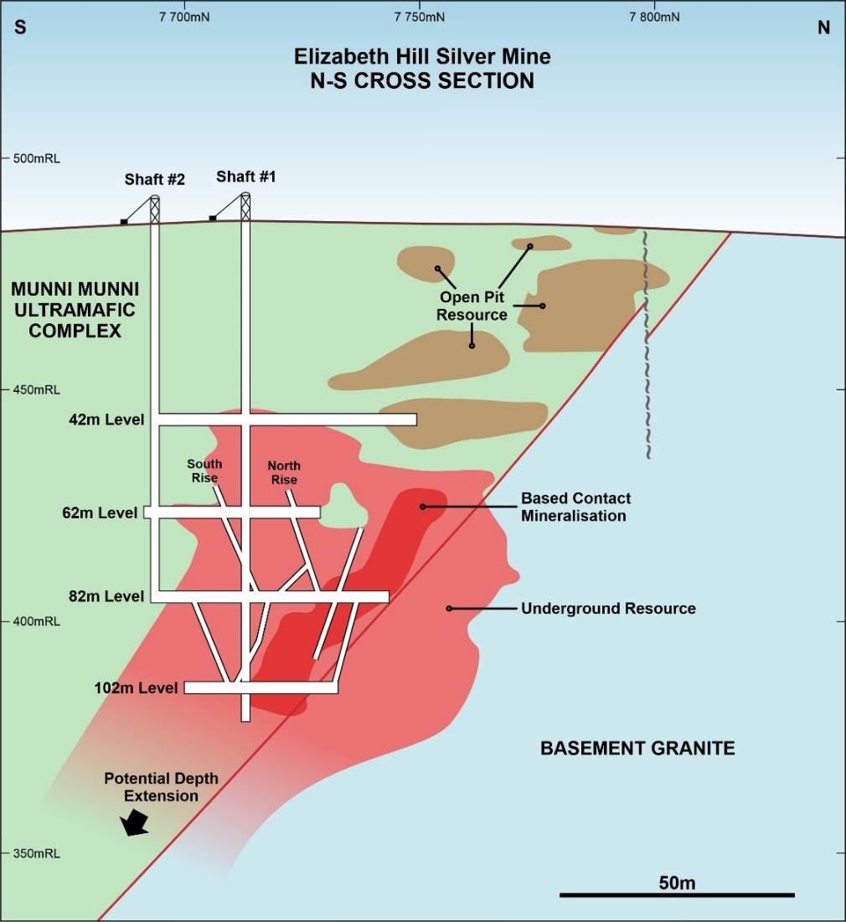
ELIZABETH HILL (SILVER)
A previously producing, historic high-grade silver mine
Operated between 1998 and 2000, producing 1.2 Moz silver at 2,195 g/t Ag (70.24 Oz/t Ag)
Produced a significant number of nuggets including the largest ever silver nugget found in Australia at 145kg
Pre JORC Compliant Resource of 4.05 Moz Ag at greater than 200 g/t Ag
Surface resource and depth extension of high-grade mineralization below 100 metres untested
Several surface robust anomalies untested within the Mining License
Opening up of underground workings to access re-entry potential
Excellent location only 40km south of Karratha, W.A.
Elizabeth Hill Silver Mine
N-S Schematic Cross Section

Slide 17
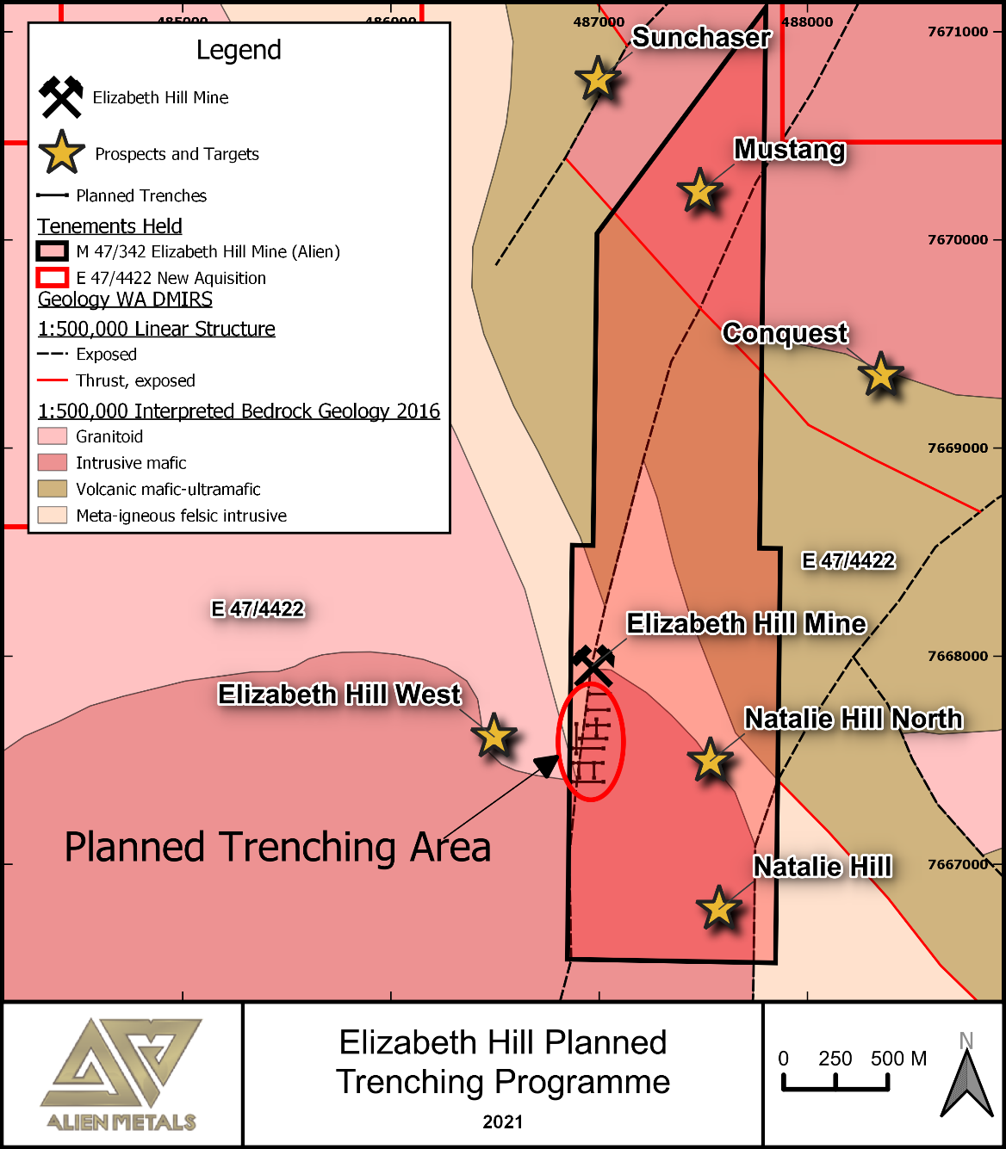
ELIZABETH HILL (SILVER)
Further exploration with significant upside potential
Review of historical data shows excellent indication for significant upside potential
Nuggets extracted worth multiple times the actual silver content
Evaluating the potential of the significant unmined resources
Potential to recommence a low cost mining operation (mining lease in place) aided by silver price
Numerous untested or not fully tested targets present
Next phase: 1.25km trenching programme, twin & new drilling to locate repeat silver orebody and follow up historic copper, nickel, PGE and gold anomalies
POW already granted for initial work
Historic underexplored prospects, Elizabeth Hill Project, November 2020

Slide 18
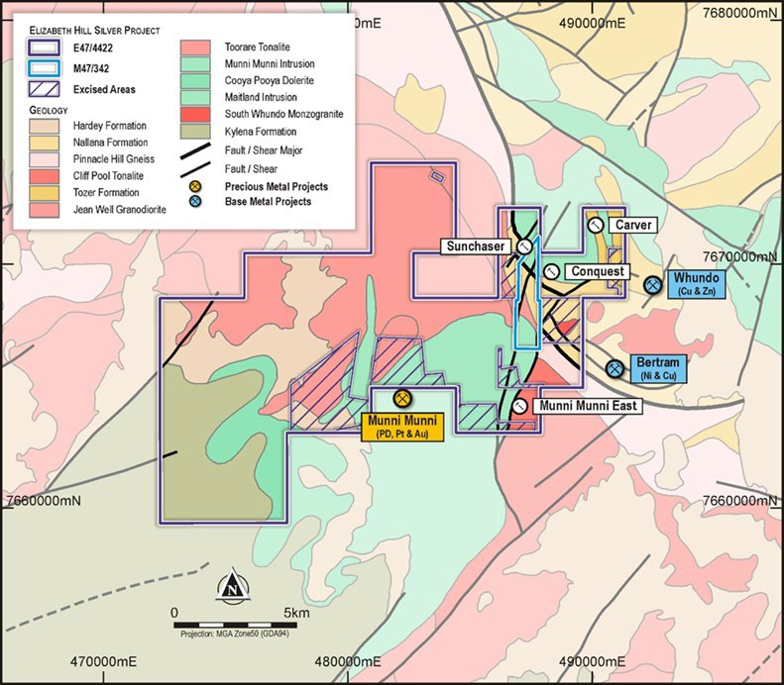
MUNNI MUNNI NORTH (NICKEL, COPPER, PGE)
Prospective new ground to explore
117km² new exploration licence acquired enveloping Elizabeth Hill Project
Several defined Prospects within new EL including:
  Sunchaser
  Carver
  Conquest
  Munni Munni East (PGM)
New prospect already defined from recent soil sample results
Excellent geological location adjacent to the 2m oz PGM Munni Munni deposit
Excellent potential for further significant discoveries
High potential for copper, nickel, PGE and gold mineralisation
Close spaced Airborne Magnetic Survey carried out early 2021 results pending
Elizabeth Hill Mine
Elizabeth Hill Silver Project showing Munni Munni North over regional geology with main historic prospects, November 2020

Slide 19
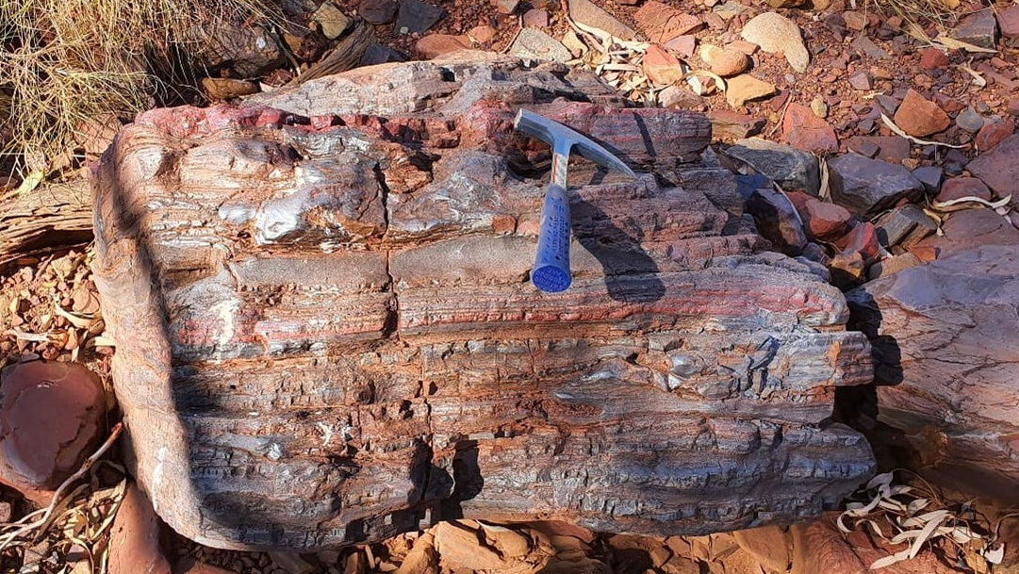
HAMERSLEY IRON ORE PROJECTS, WESTERN AUSTRALIA

Slide 20
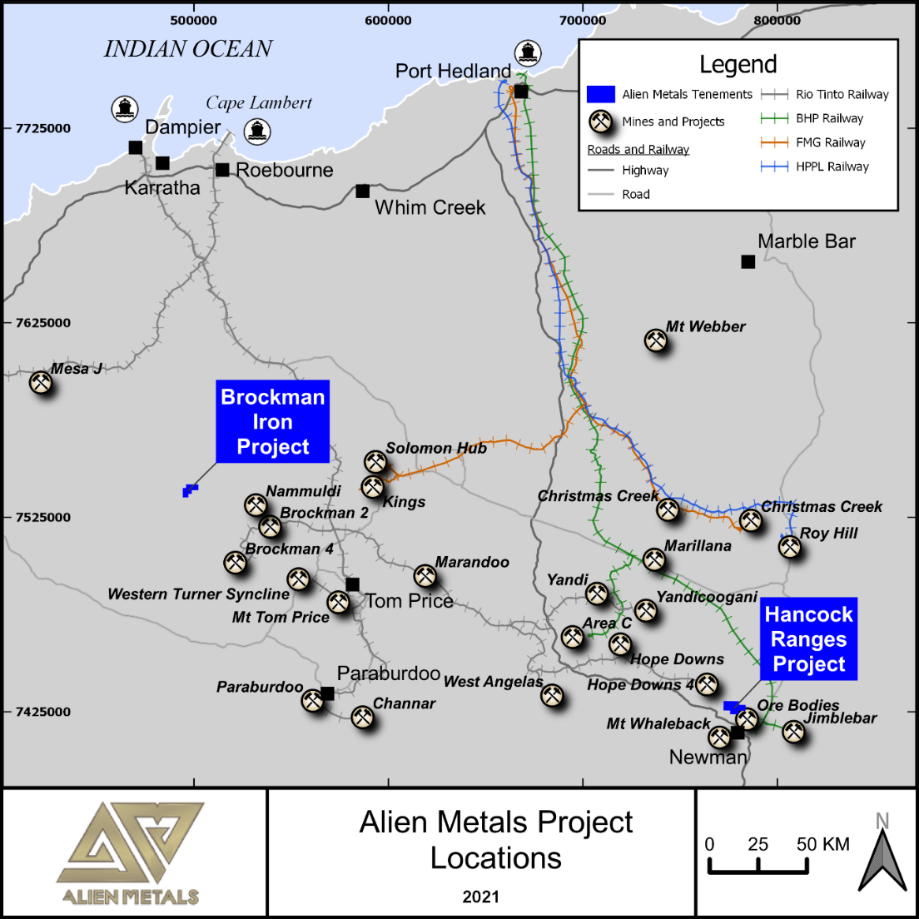
HAMERSLEY (IRON ORE)
High-grade iron ore with Direct Shipping Ore potential
51% interest in two Iron Ore licences, Brockman and Hancock, in world class Pilbara region of Western Australia
Both projects contain significant Direct Shipping Ore (DSO) potential
Major desktop study completed and field work commenced
High-grade samples at 60-65% Fe confirmed
Exploration target confirmed 50-245Mt @ between 50-65% Fe
Surrounded by major mines including Rio, BHP, Fortescue and Hancock Prospecting
Recent field work determine best exploration drill targets and areas that need further detailed mapping, sampling prior to drilling
Maiden drilling program underway on Hancock Ranges
Resource drilling on Sirius Extension planned
Location of the Hamersley Iron Ore licences
AIM:UFO | 20

Slide 21
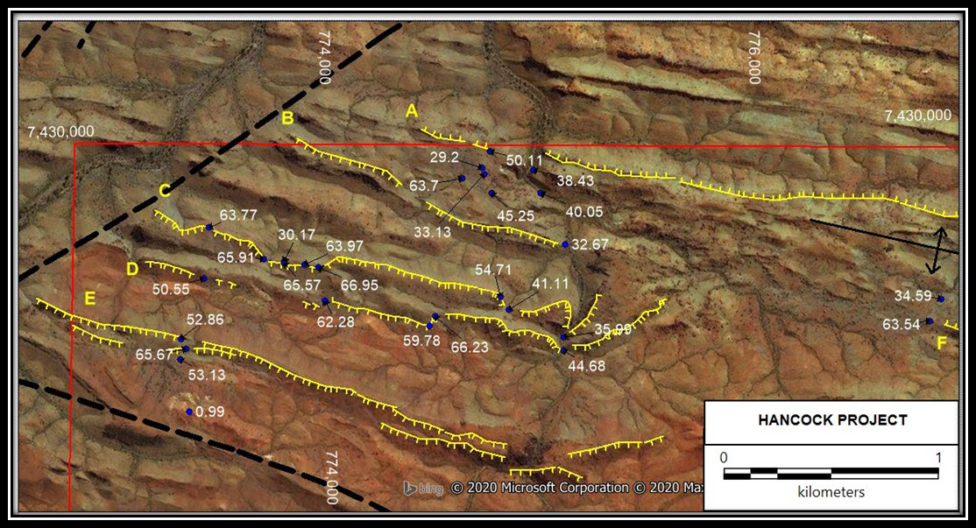
HANCOCK (IRON ORE)
Kalgan prospect highly prospective & drill ready
Excellent high grade surface samples: up to
66.95% Fe from recent field work
Parallel mineralisation identified in several prospective ridges
Underexplored, with Kalgan prospect currently mapped over 3km strike and still open
Sirius Extension prospect also confirmed potential on strike from Sirius JORC Resource of 124mt @ 60.32% Iron (Fe)
Historic drill holes on Alien’s licence returned significant results including 126m @ 60.28% Fe from surface
Funded for maiden drilling programs
Surface sampling results (% Iron) along parallel mineralised ridges over satellite image, Kalgan Prospect, Hancock Ranges Project, October 2020
AIM:UFO | 20

Slide 22
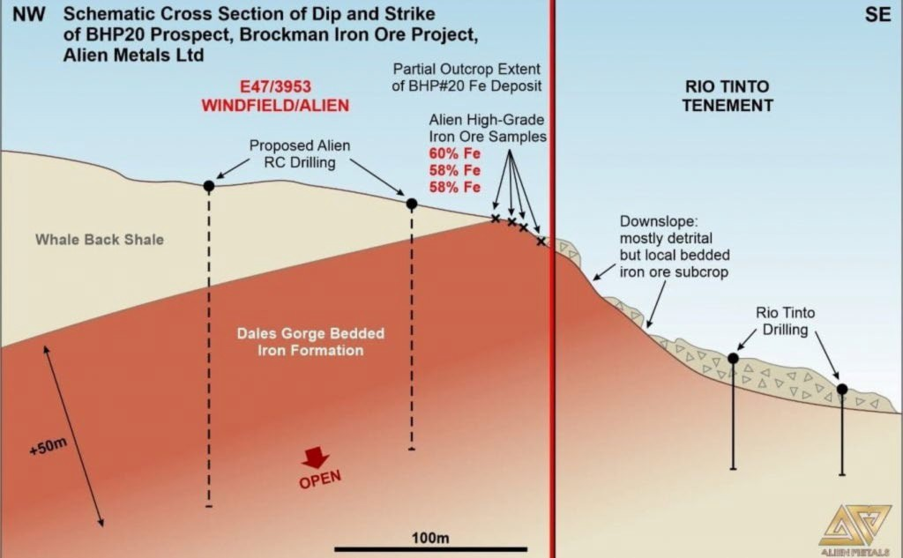
BROCKMAN (IRON ORE)
Potential for multi-million tonnes high-grade Iron Ore
Project contains prospects BHP19 and 20, defined by BHP in 1960s, and northern extension of BHP 15 prospect
Recent field work confirmed historic work by BHP: 4 samples from BHP 20 assayed:
  aaverage grade of 62% Fe
BHP 20 dipping into tenement thus having excellent potential for robust DSO resource
Tenement dominated by Brockman Iron Formation and potential significant Canga deposits, which hosts nearby iron ore mines
Due Diligence sampling returned DSO grade results including 65.4% Fe, 65% Fe, 64.3% and 60.3% Fe
The tenement appears to have further potential which is currently being explored
Schematic Cross section of BHP20 deposit, Brockman Iron Ore Project, February 2020
AIM:UFO | 22

Slide 23
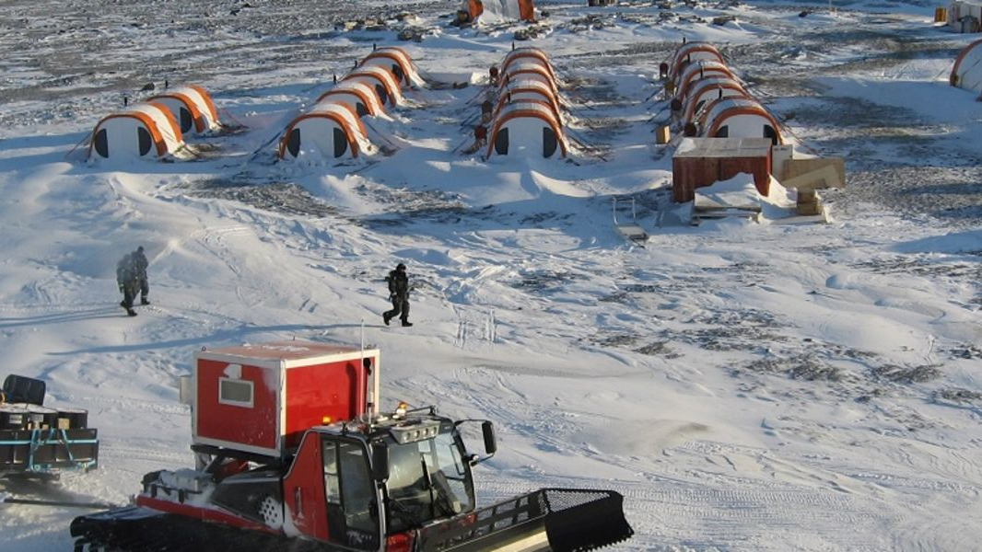
GREENLAND ZINC/LEAD PROJECT

Slide 24
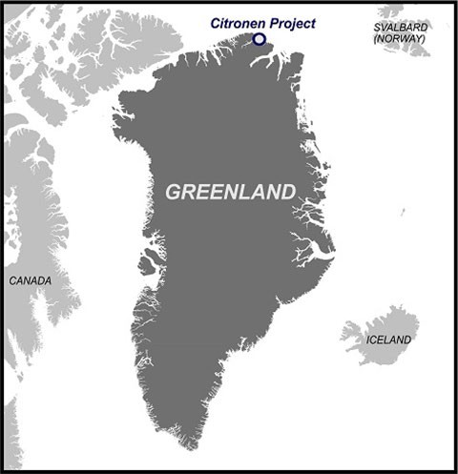
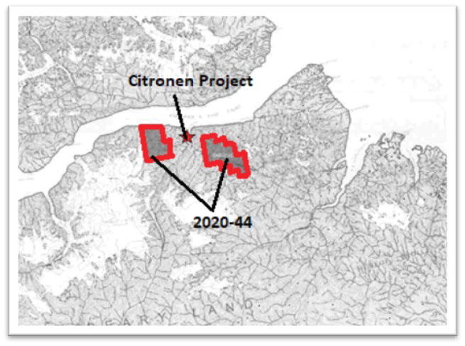
GREENLAND (ZINC/LEAD)
Early stage exploration underway to unlock potential value
Company granted 208km² exploration licence in northern Greenland.
Licence surrounds the world class Citronen Zinc-lead project owned by Ironbark Zinc Limited
Citronen contains over 3.5 million tons of zinc metal
Company commenced detailed historic review for next stage exploration planning
Low cost acquisition
JV partners currently being sought
Location of EL 2020-44, Northern Greenland, October 2020
AIM:UFO | 24

Slide 25
EXPLORATION TIMELINE 2021
Clear roadmap to growth through targeted exploration
 | JAN | FEB | MAR | APR | MAY | JUN | JUL | AUG | SEP | OCT | NOV | DEC
Donovan 2
San Celso & Los Campos *
Elizabeth Hill
Munni Munni Nth
Hancock
Brockman
EH Tailings**
Maiden Drilling Capstone
Phase 2 Drilling Capstone
Maiden Drilling
Resource Drilling
Trenching, Mapping, Underground Access, Drilling
Airmag Interpretation/
Targeting
Surface
Exploration
Surface Exploration Phase II
Maiden Drilling, Resource Drilling, Surface Exploration
Surface Exploration, Maiden Drilling
Metallurgy/Sampling/Testing
Scoping Study to Possible Processing
* Subject to permitting
** Subject to Acquisition
AIM:UFO | 25

Slide 26
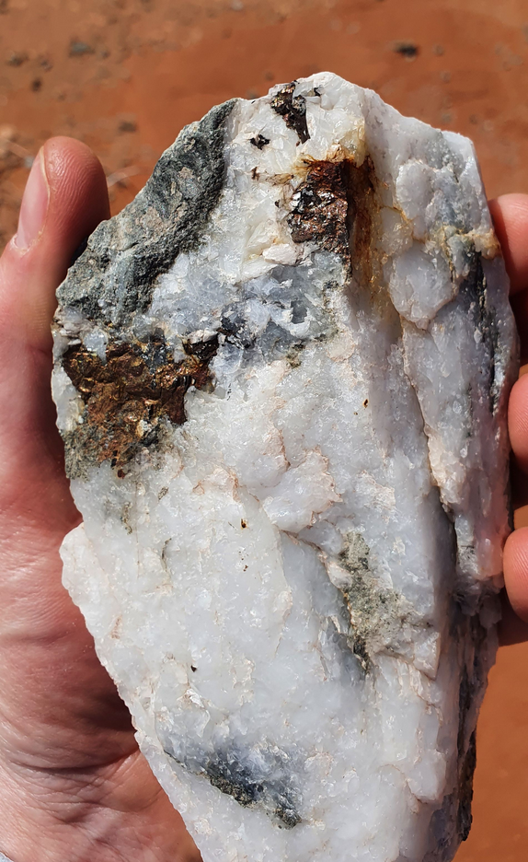
Conclusion
Strong technical and corporate experience
Diversified portfolio and upside from positive price outlooks for silver, copper and iron ore
Joint Venture partner funding up to $10m lowers risk and dilution
Projects located in tier one mining jurisdictions
Significant upside from all projects moving from exploration -> resource - > development/sale
Alien well funded with a unique opportunity for significant returns
Ore material (brown/silver inclusions) from surface dump, Elizabeth Hill Silver Mine, November 2020
AIM:UFO | 26

Slide 27
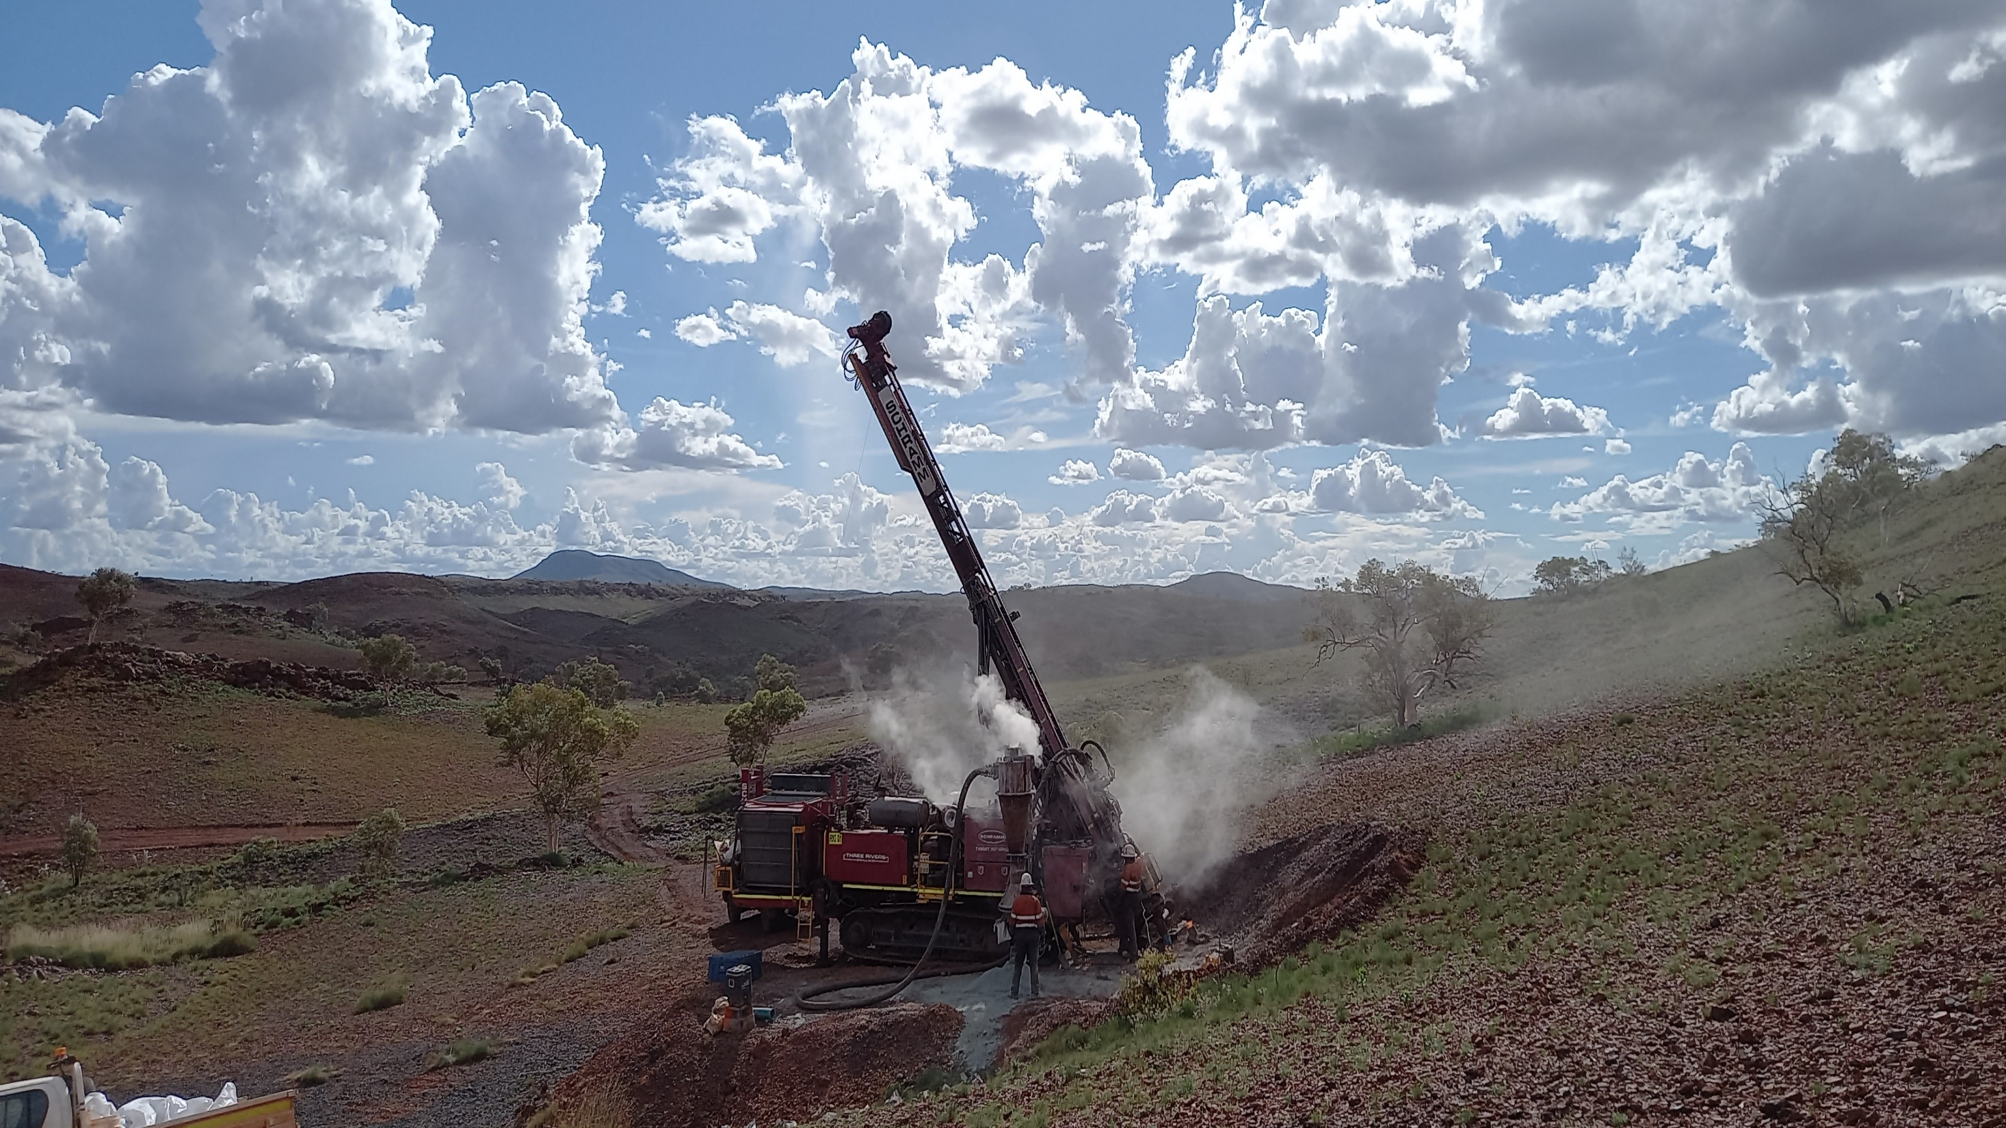
APPENDIX

Slide 28
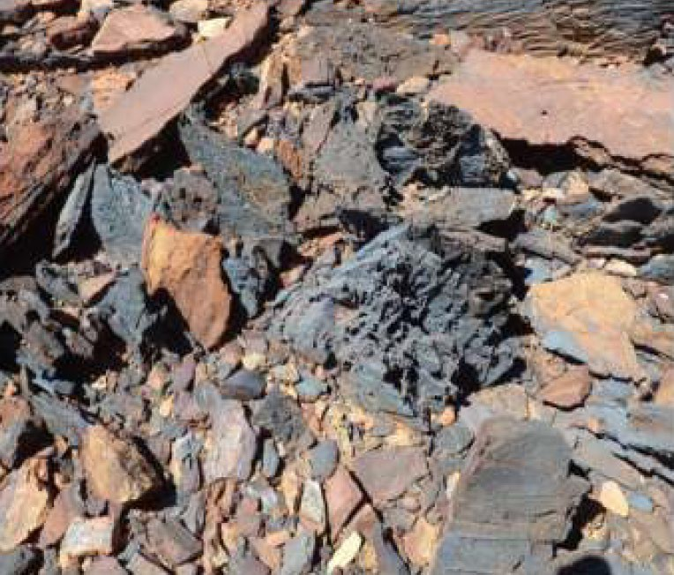
HAMERSLEY (IRON ORE)
Exploration Target
Project | Prospect | Grade Range | Low case Tonnes (Mt) | High case Tonnes (Mt)
Brockman Iron | BHP20 | 50-63% Fe | 7 | 33
Brockman Iron | BHP15 | 50-63% Fe | 60 | 200
Hancock Ranges | Sirius Extension | 56-63% Fe | 5 | 15
TOTAL |  |  | 74 | 245
Note: Exploration data utilised in the model for the Exploration Targets included geological mapping, drill hole data, surface and rock-chip sampling, iron ore assay data from drilling and rock-chip sampling and adjacent drilling and mapping of the mineralized iron ore formation
Due to lack of drilling data (primarily at BHP 20 and BHP 19) there is currently insufficient information to allow for a resource estimate in accordance with the JORC Code (2012) guidelines.
Grade Range; The iron ore grade ranges are based on the minimum and maximum assayed grades from previous drilling and sampling programmes at the Brockman Iron and Hancock Ranges projects.
Sirius Extension, Direct Shipping Ore, Sample 592802, Dec 2019
Tonnage Range: A specific gravity (SG) of three was used to calculate the tonnage ranges and are based on SG’s used by neighbouring producers/developers within the Hammersley province including Brockman Mining at their Sirius project.

Slide 29
LOS CAMPOS (SILVER)
Adjacent to currently producing mine
Alien sampling has confirmed high grade results up to 547 g/t (17 oz/t Ag)
Adjacent to Endeavour Silver mine currently producing at a plant located 10km from Los Campos
Potential to develop a mineable resource
Maiden drilling funded and environmental permission being concluded to commence as soon as feasible
Summary of high-grade samples from Los Campos 2019
Sample | Ag (g/t) | Ag (oz/t)
6940 | 161 | 5.2
6942 | 59 | 1.9
6946 | 97 | 3.1
6947 | 219 | 7.0
6959 | 94 | 3.0
6968 | 218 | 7.0
6969 | 46 | 1.5
6970 | 196 | 6.3
6977 | 222 | 7.1
6985 | 122 | 3.9
6986 | 292 | 9.4
6987 | 547 | 17.6
6988 | 274 | 8.8
6989 | 44 | 1.4

Slide 30



Contact Information
Dan Smith
Non-Executive Chairman
Bill Brodie Good
CEO and Technical Director
16 Berkeley Street, London, W1J 8DZ, United Kingdom
Yellow Jersey (Financial PR)
T +44 (0)20 3004 9512
E alienmetals@yellowjerseypr.com
@AlienMetals
linkedin.com/alienmetals

