Slide 1

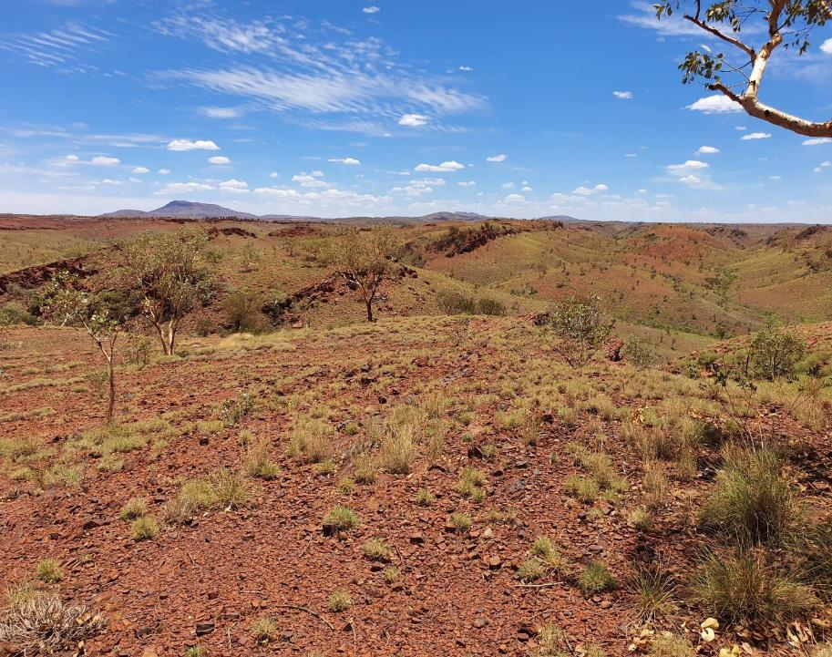

CORPORATE PRESENTATION
Precious and base metals explorer and developer
October 2021
AIM:UFO

Slide 2

Disclaimer & Competent Person Statement
The information in this presentation (the “Presentation”) relating to Alien Metals Ltd (the “Company”) has been prepared by the Company and may be subject to material updates, revision and further amendment. This Presentation is for background purposes only and does not constitute or form part of, and should not be construed as, an offer for sale or subscription of, or solicitation of any offer to purchase or subscribe for, any shares in the Company nor should it form the basis of, or be relied on in connection with, any contract or commitment whatsoever.
This Presentation has not been approved by any authorised person pursuant to Section 21 Financial Services and Markets Act 2000 ("FSMA") and is therefore being issued for information purposes only to a very limited number of persons and companies falling within one of the exemptions contained in the Financial Services and Markets Act 2000 (Financial Promotion) Order 2005 (as amended) (the "Order"). This Presentation and its contents are exempt from the general restriction (in section 21 FSMA) on the communication of invitations or inducements to engage in investment activity on the grounds that it is being given only to (i) persons outside the United Kingdom (ii) persons who have professional experience in matters relating to investments who fall within the definitions of investment professionals as defined in Article 19 of the Order (iii) persons who fall within Article 43 of the Order, (iv) and persons who fall within Article 49 of the Order (high net worth companies and trusts and other persons of the kind to which Article 49(2) of the Order applies. Persons not falling within these categories should not rely or act upon this Presentation and in consideration of receipt of this Presentation each recipient warrants and represents that he or it is a person falling within that description.
The information in this Presentation which relates to Exploration Targets, Exploration Results and Mineral Resources or Ore Reserves is based on information compiled by Mr Allen Maynard, who is a Member of the Australian Institute of Geosciences (“AIG”), a Corporate Member of the Australasian Institute of Mining & Metallurgy (“AusIMM”) and an independent consultant to the Company. Mr Maynard is the Director and principal geologist of Al Maynard & Associates Pty Ltd and has over 40 continuous years of exploration and mining experience in a variety of mineral deposit styles. Mr Maynard has sufficient experience which is relevant to the style of mineralisation and type of deposit under consideration and to the activity which he is undertaking to qualify as a Competent Person as defined in the 2012 Edition of the “Australasian Code for reporting of Exploration Results, Exploration Targets, Mineral Resources and Ore Reserves” (JORC Code). Mr Maynard consents to the inclusion of the information compiled by him in this Presentation in the form and context in which it appears.
Whilst the information contained herein has been prepared in good faith, the Company does not give or have authority to give any representations or warranties whether express or implied as to the accuracy, reliability or completeness of the information, or of any written or oral revision thereof. The Company therefore accepts no liability, whether direct or indirect, express or implied, contractual, tortious, statutory or otherwise in relation to the information contained in this Presentation.
The issuing of this Presentation does not constitute an undertaking or obligation by the Company to update or correct any inaccuracies or omissions from this Presentation which may become apparent.
All statements, other than statements of historical fact, contained in this Presentation constitute forward-looking statements based on expectations, estimates and projections as of the date of this Presentation, including but not limited to statements relating to increases in mineral resources and reserves, capital and operational expenditures and sustaining capital, cash costs per ounce, grades and recoveries, NPV and IRR, the Company’s results of operations, financial position, revenue, profit, silver production, liquidity, availability of finance, prospects, growth, strategies, the silver price and the silver industry.
Such forward-looking statements are subject to a number of risks, uncertainties and other factors which may cause actual results, performance and developments to differ materially from those expressed or implied by such statements including, without any limitation whatsoever, the availability of mining, environmental or other operating permits; the failure of plant, equipment or processes to operate as anticipated; the speculative nature of mineral exploration and development; operating or technical difficulties in mineral exploration; development and mining activities; reliability of calculation of mineral reserves and resources and precious metal recoveries; availability, of and costs associated with, mining inputs and labour; accidents; requirement for additional capital; the price of silver; general economic and business conditions; industry trends; competition; changes in regulation; taxation; controls and legislation; currency fluctuations (including the US dollar, Australian dollar and Mexican Peso exchange rates); the Company’s ability to develop new reserves, including its ability to convert its resources into reserves and its mineral potential into resources or reserves; changes in its business strategy; changes in national and local governments; and political and economic uncertainties. Therefore, although the Company believes that the expectations reflected in such forward-looking statements are reasonable, the Company neither gives assurance that such expectations are accurate or guaranteed nor assumes any obligation to update the information contained therein, other than as required by the applicable law.

Slide 3

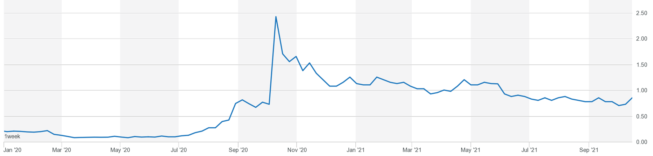


CAPITAL STRUCTURE
KEY DATA
UFO Share Price
AIM
MARKET
UFO
TICKER
£24.87m
MARKET CAP
0.58p – 2.88p
52 WEEK SHARE PRICE
3,430m
ISSUED SHARE CAPITAL
74.8m
DIRECTORS OPTIONS
1.9b volume of shares traded in 6 months
Source: London Stock Exchange
Past performance is not indicative of future results.
391m
SHARE WARRANTS
MAJOR SHAREHOLDERS
Bennelong
Gravner
6.4%
5.9%
**Warrants exercisable at between £0.0012 and £0.006 expiring between 31 January 2020 and 30 November 2023.
Figures as of 15 October 2021

Slide 4

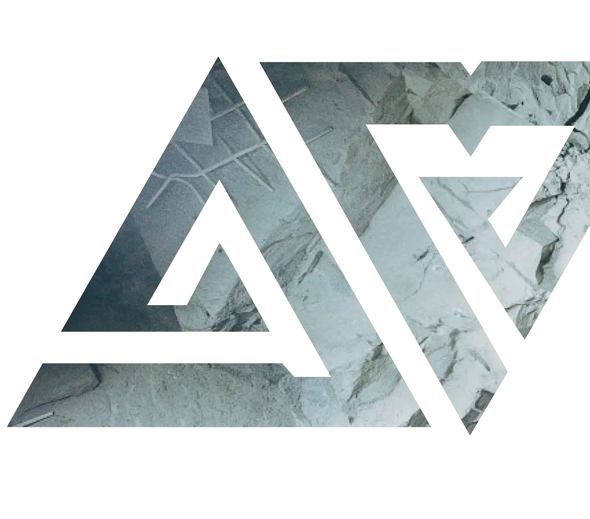
BOARD AND MANAGEMENT
Recognised experts in global mining with a proven track record of building value
DAN SMITH
Non-Executive Chairman
13+ years capital markets experience as Director of AIM/ASX resources companies
Founder of Minerva Corporate Pty Ltd
Current board positions Europa Metals (AIM), White Cliff Minerals (ASX) and Artemis Resources (ASX)
BILL BRODIE GOOD
CEO & Technical Director
25+ years in mineral exploration
5 years as a Principal with SRK Exploration Services Ltd, a leading global mining consultancy group
Extensive experience setting up exploration projects throughout Africa, Asia and Australia
MARK CULBERT
Non-Executive Director
Founding Partner of corporate and commercial litigation firm, over 20 years legal and business experience
HOWARD BAKER
Resource Geologist and QP, Iron Ore
With over 20 years experience in Iron Ore project evaluation, exploration and Resource calculation Howard brings a wealth of experience to the team.
JO BATTERSHILL
Corporate Advisor
Jo’s mining career spans over 25 years in operations, business development and finance-based roles across Australia, the UK, North America and the Caribbean.

Slide 5
MULTI-COMMODITY PORTFOLIO
A global, diversified mining company with prospective projects in Mexico, Australia and Greenland
AUSTRALIA
Ag
Ni
Cu
PGE
Fe
GREENLAND
Elizabeth Hill (100%) - Silver
Historic high-grade silver mine
Grade averaging 2,195 g/t Ag Inaugural drilling program underway
Munni Munni North
117km² exploration permit around Elizabeth Hill
Numerous Ni, Cu, PGE targets
Exploration planning underway
Hamersley (90%) - Iron Ore
MRE 10.4Mt @ 60.4% Fe with upside potential to be explored on Hancock Project
Brockman reconnaissance program in planning
Zn
EL 2020-44 - Zinc
208km² surrounding Citronen Zinc-Lead project owned by Ironbark Zinc (ASX: IBG)
Data review underway
Seeking Joint Venture partner
Ag
Ag
Cu
Au
MEXICO
Los Campos (100%) - Silver
Historic mine in Zacatecas
High grade samples include 547 g/t Ag
Maiden Drill program due 2021
Donovan 2 (100%) – Copper/Gold
25km from Teck San Nicolas VMS deposit
Sample results 3.34% Cu and 2.68 g/t Au
Alien drill program being finalized
San Celso (100%) - Silver
2 historic underground silver mines.
High grades up to 1,389 g/t Ag, average of 441 g/t Ag.
Maiden Drilling program due 2021

Slide 6
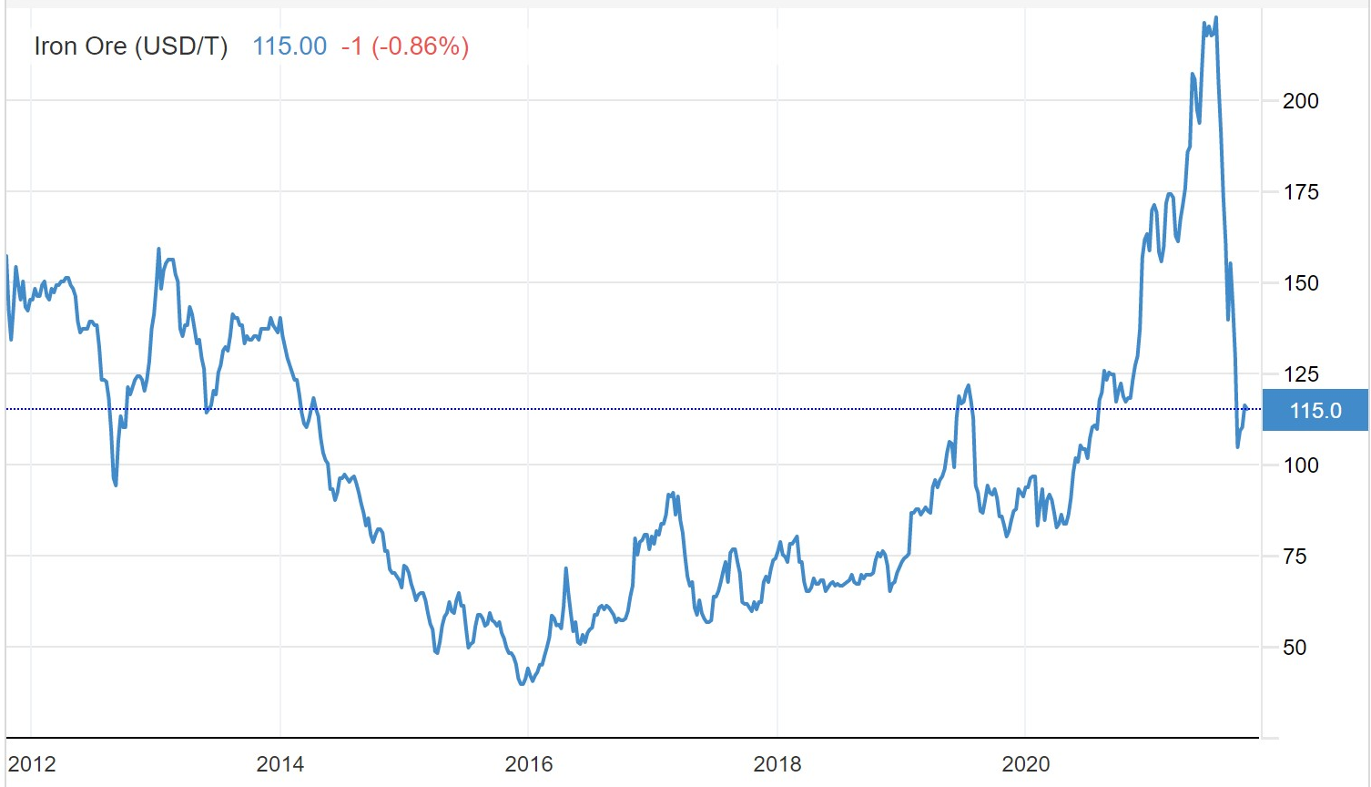
COMMODITY OUTLOOK
DSO Grade Iron Ore has performed strongly and has strong price outlooks
Fe
Iron Ore
Key component in steelmaking and thus driven by spend on construction and infrastructure
DSO grade price volatile but remaining strong vis a vis Alien projects
Recent price fluctuation does not affect Hancock project economics
Long term outlook maintains viability of DSO grade projects
Investment in infrastructure a key pillar of growth in the region
Global supply seeing significant squeeze, driving prices further
Iron Ore - 10-year Chart
Source: https://markets.businessinsider.com/commodities/iron-ore-price

Slide 7
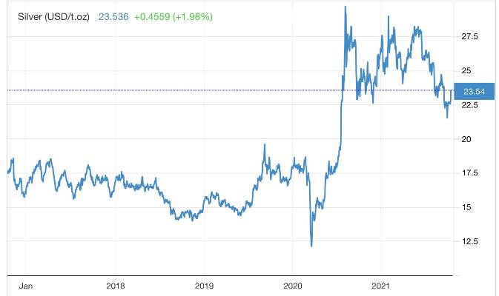
COMMODITY STRENGTH
Silver, Copper and Iron Ore have performed strongly and have excellent long-term outlooks
Ag
Silver
Vital component in solar cells, electronics, Battery Electric Vehicles (BEVs)
Wide applications in healthcare, including the manufacture of PPE
Increased fiscal stimulus globally driving further investment demand
Price significantly higher from March 2020 low
Maintaining strong levels @ $23 USD/Oz
Gold/Silver Ratio down from +110:1 to 75:1
Increasingly being seen as a viable store of value by investors, similar to gold
Silver- 5-year Chart
Source: https://markets.businessinsider.com/commodities/iron-ore-price

Slide 8
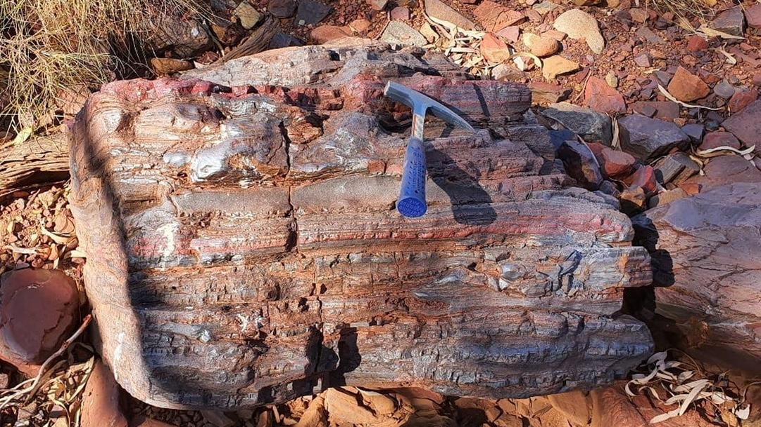
HAMERSLEY IRON ORE PROJECTS, WESTERN AUSTRALIA

Slide 9
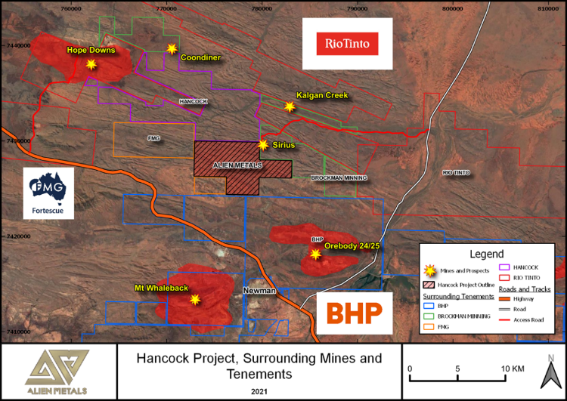
HANCOCK PROJECT
Maiden DSO Resource defined in 20 months
51%* interest in two Iron Ore licences, Brockman and Hancock, in world class Pilbara region of Western Australia
Maiden JORC compliant Inferred resource defined for Hancock Project of 10.4 Mt @ 60.4% Fe
Scoping Study for Hancock Project very solid with excellent economics
Hancock contains significantly more Direct Shipping Ore (DSO) potential Alien working to define
Brockman Tenement still to be drilled but also hold significant upside potential
* UFO has entered a conditional agreement to acquire a further 38% interest in the projects
Supporting RNS: Scoping Study delivers compelling development case for the Hancock Iron Ore Project
AIM:UFO | 20

Slide 10
Hancock Ranges Project – Maiden Resource defined
Inaugural DSO JORC Compliant Resource Estimate
Classification Category | Target | Mass (Million tonnes) | Average Value
Classification Category |  |  | Fe | SiO₂ | Al₂O₃ | P | LOI | MnO
 |  |  | % | % | % | % | % | %
Inferred | Sirius Extension | 7.8 | 60.1 | 4.1 | 3.72 | 0.17 | 5.2 | 0.05
 | Ridge E | 1.5 | 61.2 | 4.8 | 3.38 | 0.13 | 3.5 | 0.02
 | Ridge C | 1.1 | 61.9 | 4.4 | 2.93 | 0.12 | 3.5 | 0.03
Total |  | 10.4 | 60.4 | 4.2 | 3.6 | 0.16 | 4.8 | 0.04
Mineral Resource Estimate was completed by Baker Geological Services Ltd
Supporting RNS: Alien to announce results of Scoping Study on Hancock Iron Ore Project
AIM:UFO | 20

Slide 11
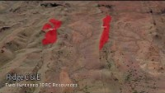
Hancock MRE Video

Slide 12
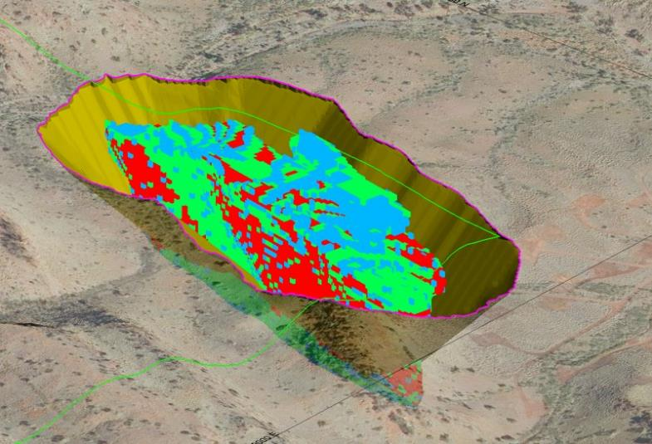
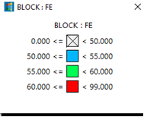
Hancock Project
Inaugural Scoping Study
Maiden JORC compliant resource defined from only 2 RC drilling campaigns
The Mineral Resource Statement (“MRE”) has been restricted to material that falls within an optimised open pit shell and within the tenement boundary.
Optimised pit shells at 100 USD/t result in complete orebody extraction as optimum mining plan
Strip Ratio extremely low
Capex requirement repaid in first year of production
Ridge E
Sirius Extension pit looking Northwest
Supporting RNS: Scoping Study delivers compelling development case for the Hancock Iron Ore Project
AIM:UFO | 20

Slide 13
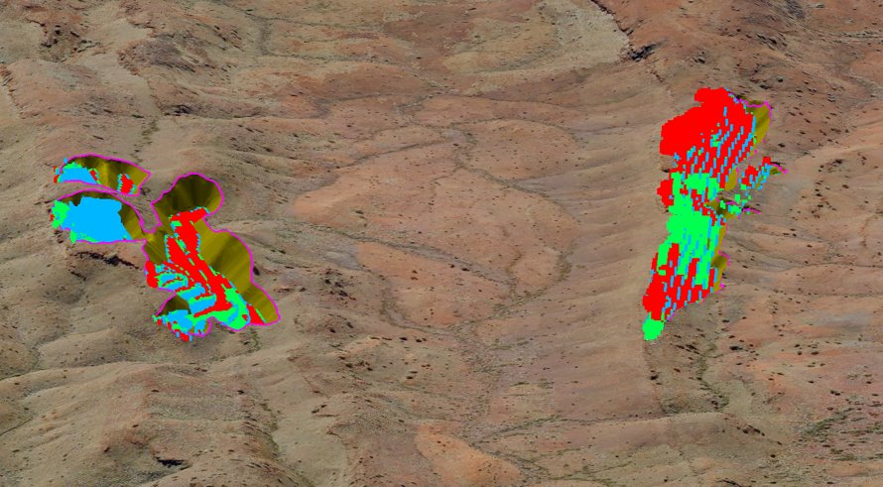
Key Scoping Study Results Hancock Project
> $60 USD/t FOB to port based on near identical in production project
FOB inclusive of:
  all mining costs
  all transport costs
  Royalties
  Port costs
1.25Mt/annum mine schedule with half production for first year
Very low Capex < $30m USD repayable in first year
Near 1:1 Strip Ratio on Ridge orebodies and only 1:1.8 on Sirius Extension Pit
Ridge C Pit looking east
Ridge E Pit looking east
Supporting RNS: Scoping Study delivers compelling development case for the Hancock Iron Ore Project
AIM:UFO | 20

Slide 14
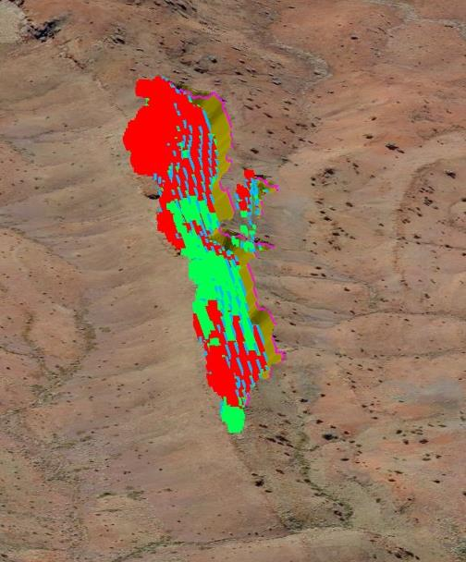
Scoping Study Hancock Project
Mining Parameters Very Simple
The Ridge deposits DSO material are contained in the ridge tops which adds huge benefits to the mining process
Little to no strip ratio
Ore at surface/outcrop so can access directly
Trend of ore conducive for Surface Mining unit, very mobile and efficient
Mobile screening and crushing method negates expensive plant construction & minimize ore movement
Trend of Ridge E
AIM:UFO | 20

Slide 15
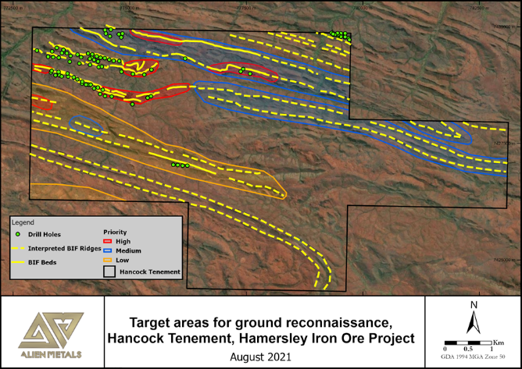
Hancock Ranges Project – Tenement potential
Huge additional resource potential in remainder of the tenement to develop
Parallel mineralisation has now been confirmed across several ridges parallel with the regional E-W strike within the tenement
Current Ridge E resource of 1.5Mt @ 61.2% Fe within strike length of 1.2km
Ridge E is interpreted to continue a further 9km east within the tenement which is untested to date
Current Ridge C resource of 1.1Mt @ 61.9% Fe within strike length of 0.9km
Ridge C is interpreted to continue a further 7.5km east within the tenement which is untested to date
Several ridges run parallel to Ridge C and E across the tenement which remain untested
Remaining 70-80% of tenement still to be explored but showing excellent potential for further mineralisation
Phase III drilling hoped to occur in Q4 2021 with aim of initial resource drilling of the Western Ridges prospect, extending known mineralisation as required to upgrade the mineral resource.
Supporting RNS: Scoping Study delivers compelling development case for the Hancock Iron Ore Project
AIM:UFO | 20

Slide 16
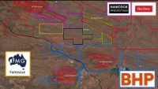
Hancock Scoping Study Video

Slide 17
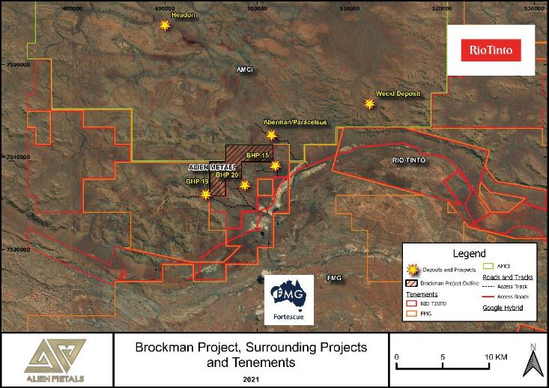


Brockman Iron Ore Project
Potential for further DSO grade Iron Ore
Project contains edge of historic BHP deposit 19, BHP 20 deposit and northern extension of BHP 15 deposit
Recent field work confirmed historic work by BHP who reported 4 samples from BHP 20 assayed:
  59.5% to 63.5% Fe (Average 62% Fe)
Tenement dominated by the Brockman Iron Formation along with potential significant Canga deposits, which hosts nearby iron ore mines
Due Diligence sampling returned DSO grade results including 65.4% Fe, 65% Fe, 64.3% and 60.3% Fe
The tenement still underexplored and requires more mapping and maiden drilling
Drilling by FMG and Rio on the southern border of Alien tenement
Supporting RNS: Conditional Agreement for Alien Metals to increase interest in Hamersley Iron Ore Project to 90% Excellent results from maiden drilling program and Iron Ore price performance underscore the rationale

Slide 18
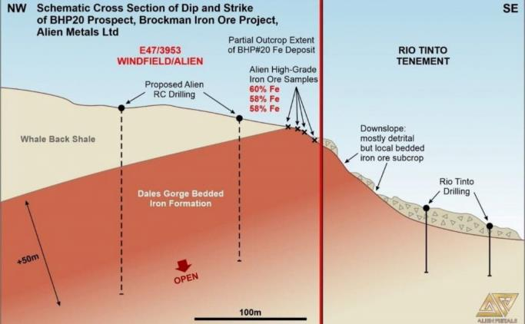
Brockman Iron Ore Project (Cont.)
Project contains prospects BHP19 and 20, defined by BHP in 1960s, and the northern extension of BHP 15 prospect
Recent field work confirmed historic work by BHP: 4 samples from BHP 20 assayed:
  average grade of 62% Fe
BHP 20 dipping into tenement thus having excellent potential for robust DSO resource
Tenement dominated by Brockman Iron Formation and potential significant Canga deposits, which hosts nearby iron ore mines
Due Diligence sampling returned DSO grade results including 65.4% Fe, 65% Fe, 64.3% and 60.3% Fe
Alien completing necessary Heritage surveys to enable drill permitting for maiden drilling program soonest
Schematic Cross section of BHP20 deposit, Brockman Iron Ore Project, February 2020
Supporting RNS: Maiden Exploration Targets Identified at Hamersley Iron Ore Projects

Slide 19
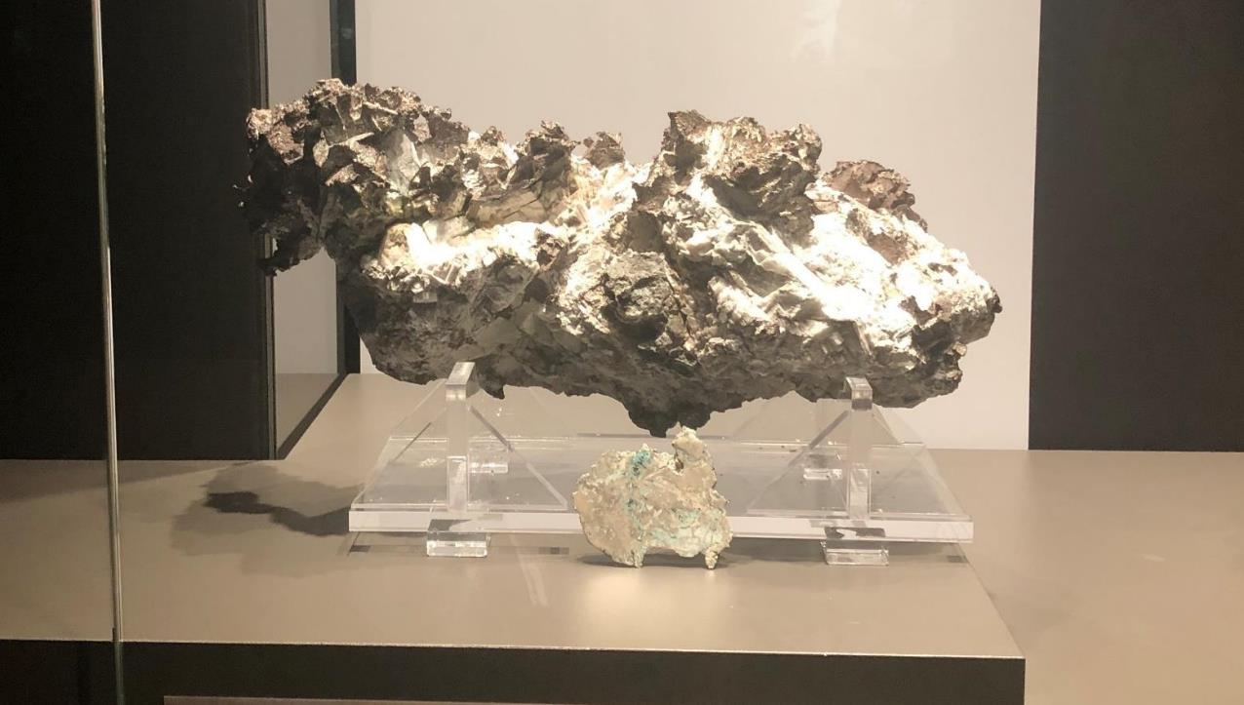
ELIZABETH HILL SILVER PROJECT, WESTERN AUSTRALIA

Slide 20
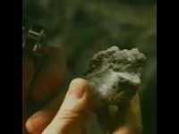
Elizabeth Hill UG Video

Slide 21
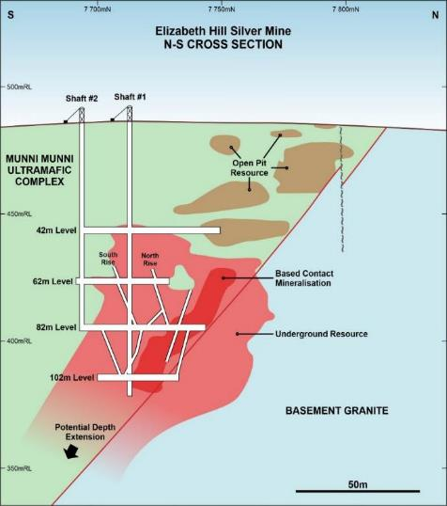
ELIZABETH HILL (Silver, Copper, Nickel)
A previously producing, historic high-grade silver mine
Mined between 1998 and 2000, producing 1.2 Moz silver at 2,195 g/t Ag (70.24 Oz/t Ag)
Produced a significant number of nuggets including the largest ever silver nugget found in Australia at 145kg
Pre JORC Compliant Resource of 4.05 Moz Ag at greater than 200 g/t Ag
Surface resource and depth extension of high-grade mineralization below 100 meters untested
Copper, Nickel, Cobalt halo around silver orebody never properly tested
Several surface robust anomalies untested within the Mining License
Opening up of underground workings to access re-entry potential imminent
Excellent location only 40km south of Karratha, regional centre
Elizabeth Hill Silver Mine
N-S Schematic Cross Section
Supporting RNS: Completion of Strategic Silver Tenement Acquisition & Silver Projects Update

Slide 22
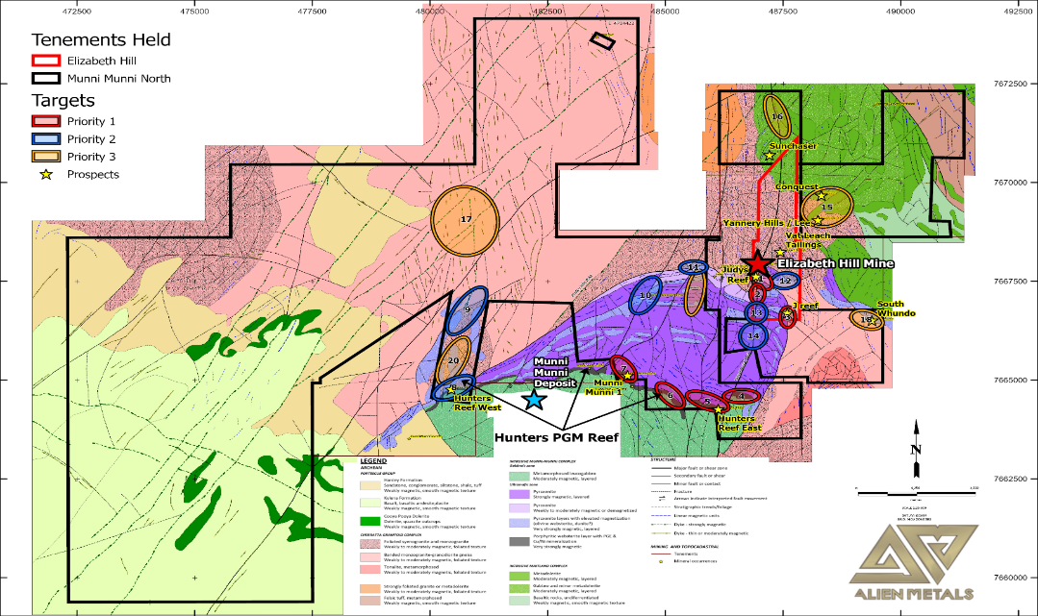

Slide 23
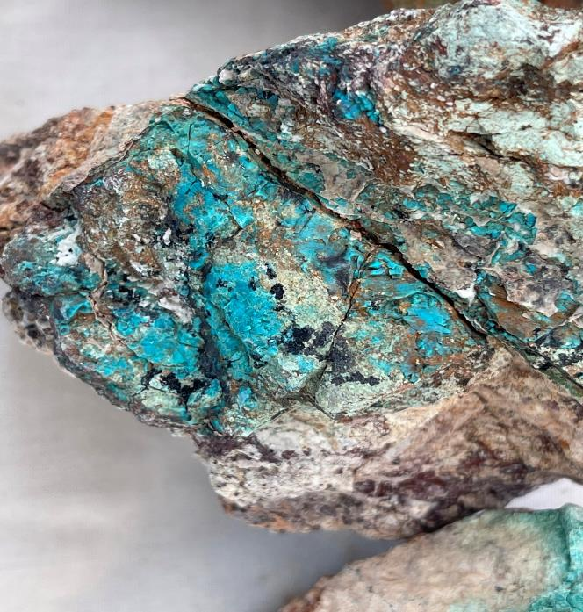
Conquest Prospect surface sample with
pervasive azurite inclusions

Slide 24
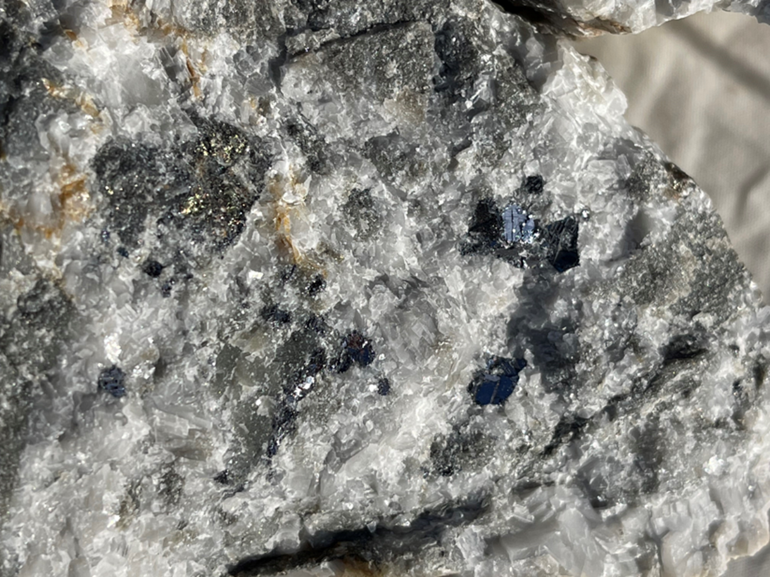
Sample of ore from Low Grade
waste dump at Elizabeth Hill
containing silver and sulphides

Slide 25
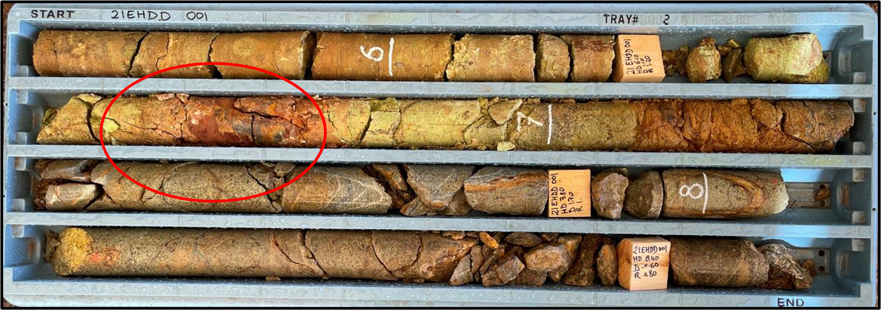
Diamond Hole EHDD001, Tray 2, 5.5 – 8.7m, 1.4% silver on pXRF at 6.4m

Slide 26
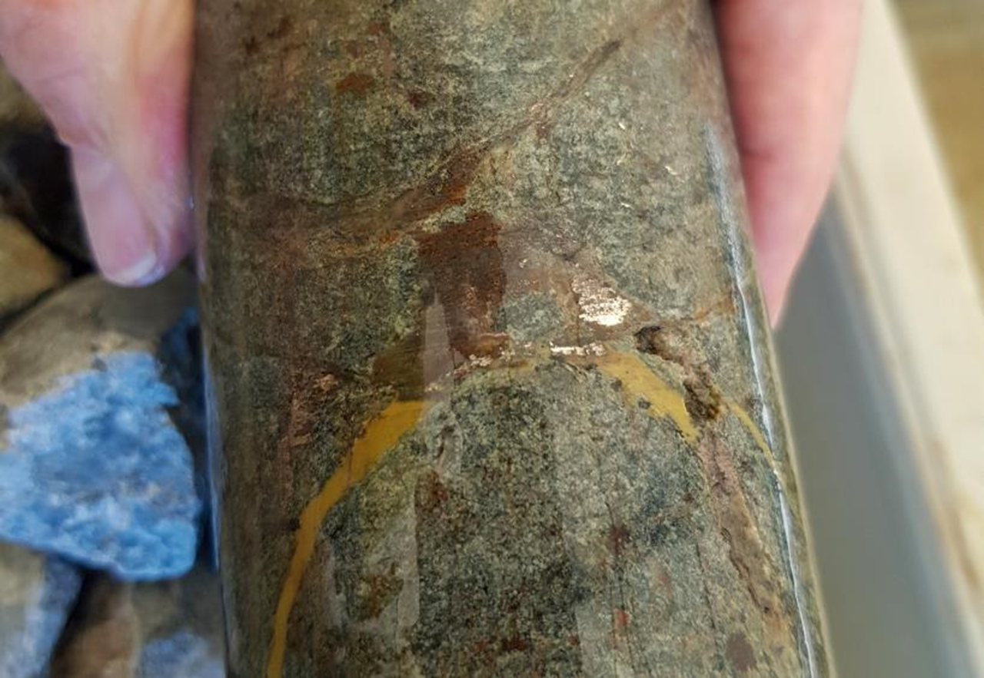
Hole EHDD003, 24m depth,
Native silver and sulphides in
Veining and dissemination,
2,300 g/t Ag reading on pXRF
End of hole 1.5 % silver reading

Slide 27
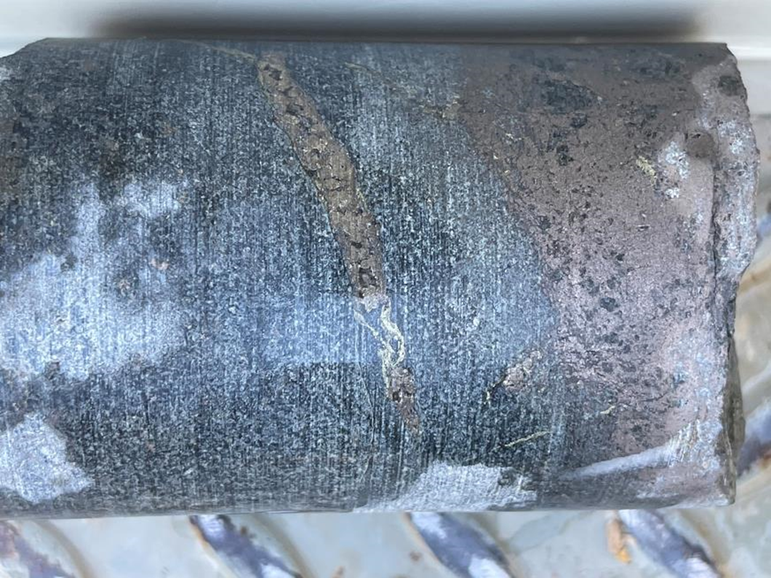
EHDD004 at 91.7m
pXRF readings include:
2.8 % Nickel
0.2 % Cobalt
0.2 % Copper

Slide 28
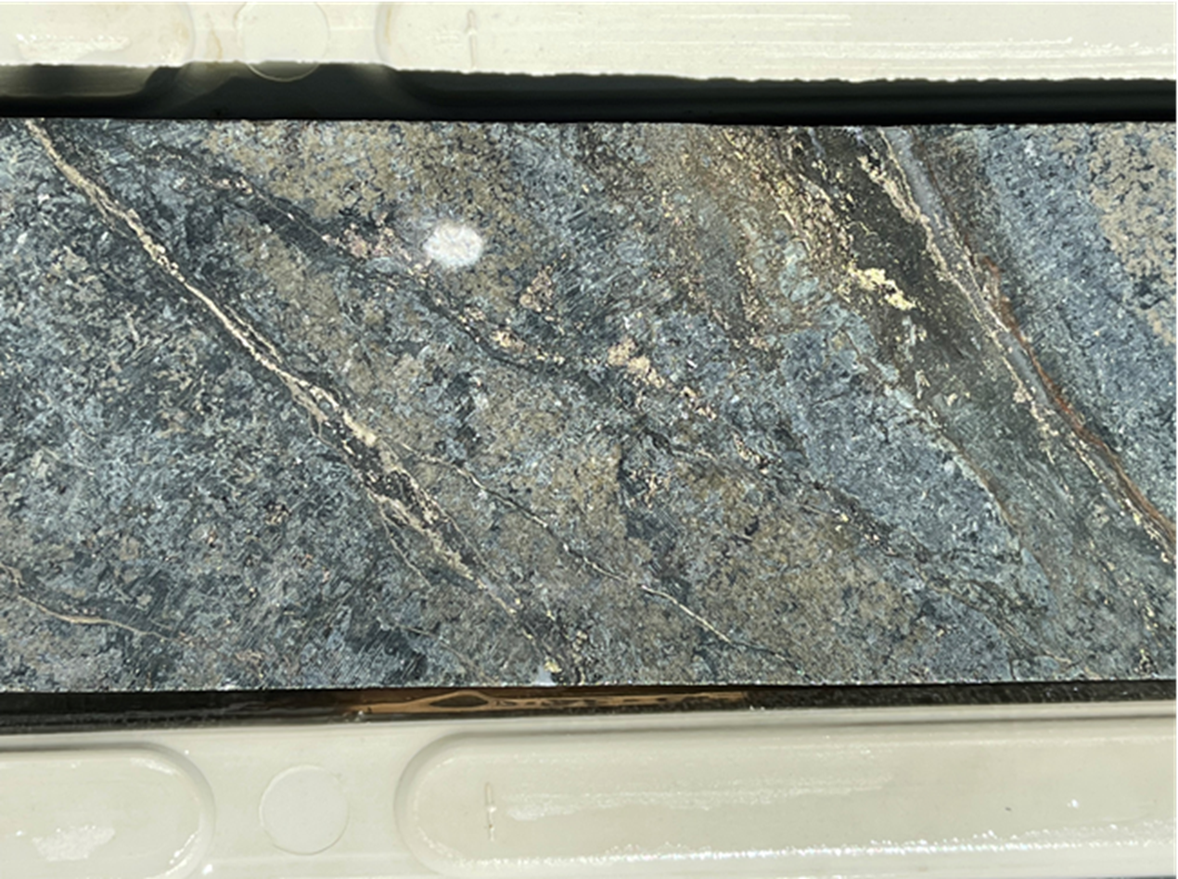
EHDD004 at 87.6m
pXRF readings include:
0.75% Nickel
0.6% Copper
390 g/t Cobalt

Slide 29
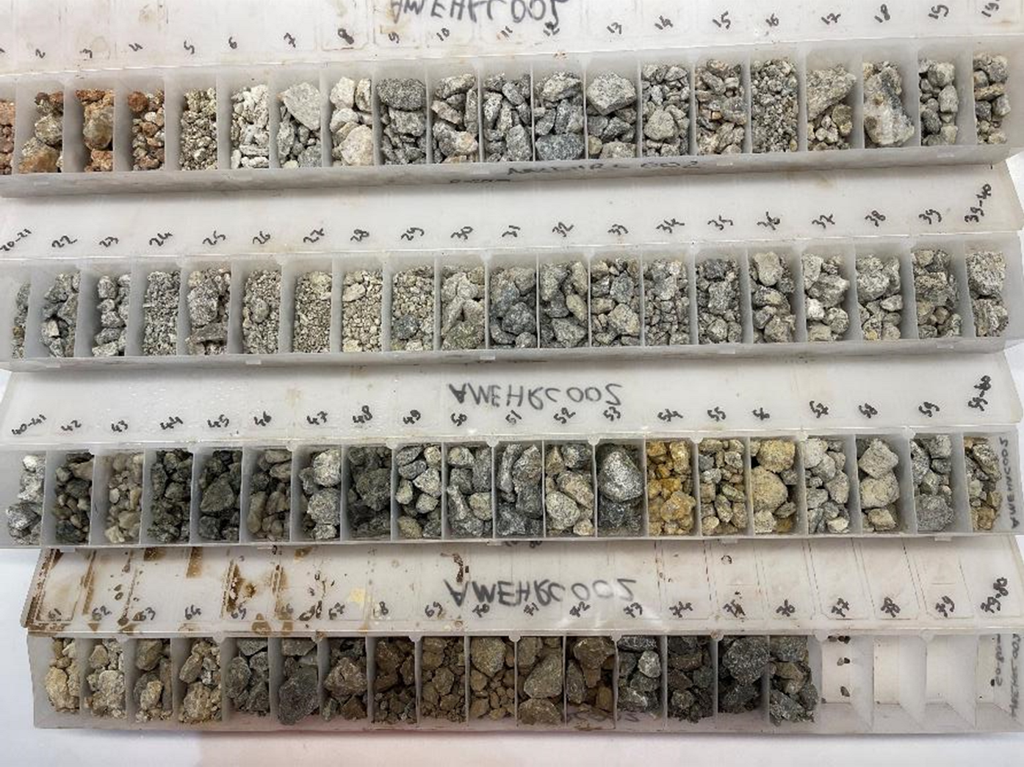
AMRC002
Chip Trays

Slide 30
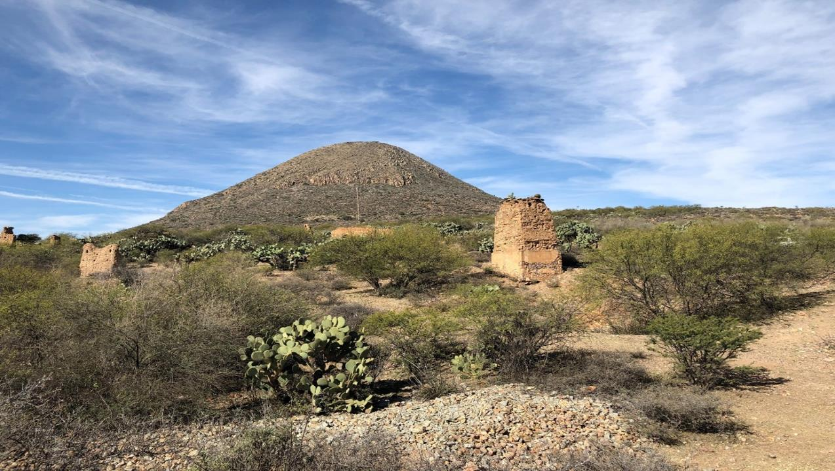
MEXICAN COPPER/GOLD & SILVER PORTFOLIO

Slide 31
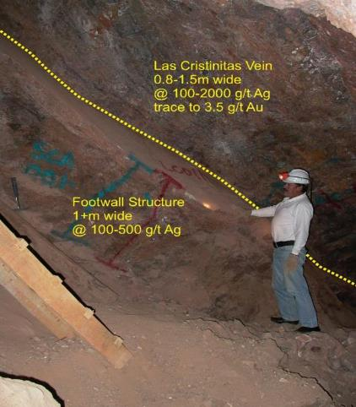
SAN CELSO (SILVER)
Bonanza Grades
San Celso hosts two historic underground silver mines that contained Bonanza Grades:
  Historic grades up to 2683 g/t Ag (~86 oz/t Ag)
  Recent sample grades up to 1,389 g/t Ag (~44 oz/t Ag), averaging 441 g/t Ag (~14 oz/t Ag) from 96 samples
Numerous stopes indicating the presence of high-grade silver ore shoots off main veins
Footwall mineralisation also apparent yet unmined
800m+ known strike of main vein systems within current licence area, open at depth
Indications are mineralization continues at depth below historic mining and on strike in both directions
Funding available for maiden drilling
Environmental permit for drilling being sought
Contiguous Nueva Andromeda Permit acquired by Alien early 2021 to add potential
Las Christinitas Ore Body in historic workings, San Celso Project, 2006

Slide 32
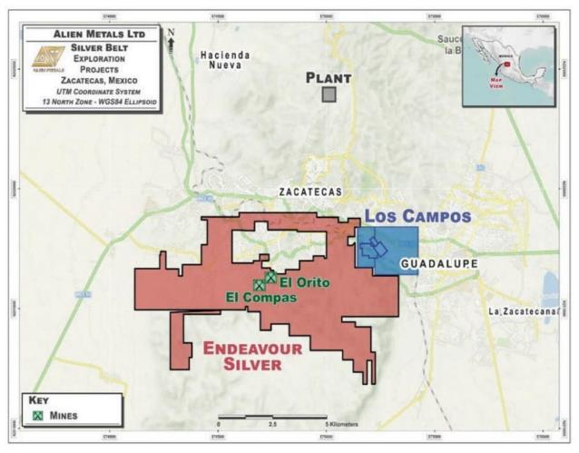
LOS CAMPOS (SILVER)
Average reported head grade of over 1,000 g/t Ag
10km east of Endeavour Mining Corp’s 6moz El Campos Silver Mine
  Comparable mineralized system
Los Campos includes:
  Two historic silver mines targeting two high-grade epithermal silver veins
  Average reported head grade of over 1,000 g/t Ag
  Historic waste/ore dumps remain to be tested for silver content
  Recent high-grade samples taken by Alien including 547 g/t Ag (18oz/t)
Maiden Drill program permission being sought
Alien funded for Maiden Drilling program
Alien recruited a permanent Senior Geologist based in Zacatecas early in 2021 to the team to increase presence and technical capacity in country
Location of Los Campos Project in relation to Endeavour Silver El Campos Silver Mine, Mexico Silver Belt

Slide 33
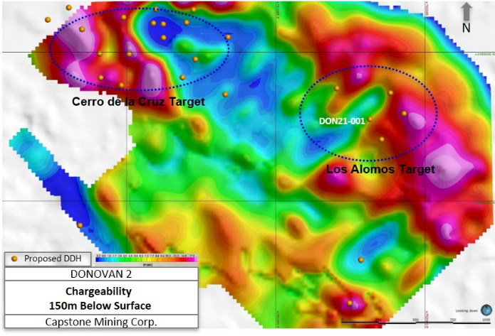
DONOVAN 2 (COPPER/GOLD)
Alien working up next exploration phase
Close spaced in-fill IP survey in 2020 by Capstone helped outline Drill Targeting
Significant samples from Los Alomos target to be drill tested by Alien
  3.34% Cu
  2.68 g/t Au
Alien to finalise drill plan to compliment and test main Los Alomos target
Located 24km from Teck Resources San Nicolas Project, resource:
  108Mt @ 1.16% Cu, 1.6% Zn,
0.43 g/t Au and 24.5 g/t Ag
Location of provisional drill holes over Chargeability -150m depth, Donovan 2, February 2021 (Capstone Mining Corp.)
Supporting RNS: Drilling commences at Donovan 2 Copper Gold Project

Slide 34
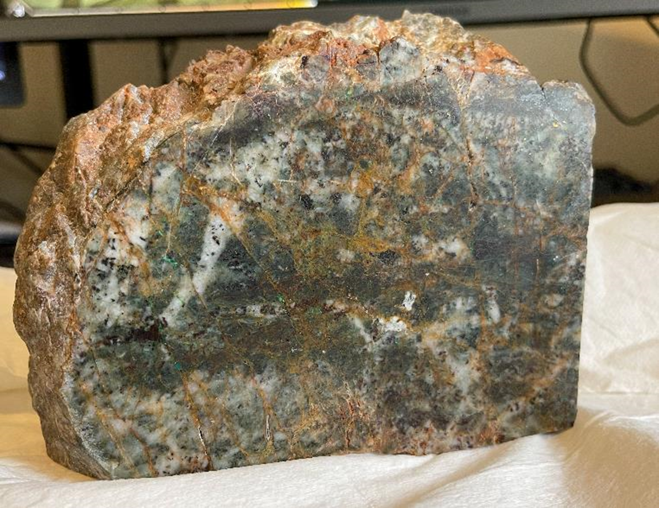
Polished sample from Los Alomos Prospect, Donovan 2 water well returned 3.3% Cu

Slide 35
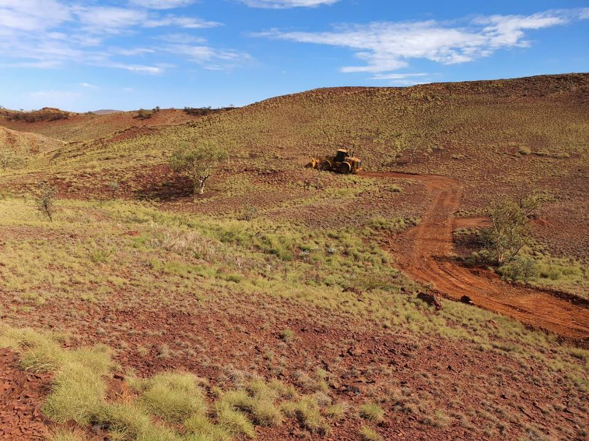

Contact Information
Dan Smith
Non-Executive Chairman
Bill Brodie Good
CEO and Technical Director
Green Park House, 15 Stratton Street, London, W1J 8LQ, United Kingdom
Yellow Jersey (Financial PR)
T +44 (0)20 3004 9512
E alienmetals@yellowjerseypr.com
@AlienMetals
linkedin.com/alienmetals

